Slide 1
Organizational Behavior
Module 15: Organizational Change
Notes:
Cover Image: "Untitled." Authored by: StartupStockPhotos. Provided by: Pixabay. Located at: https://pixabay.com/en/ideation-startup-entrepreneur-3267505/. Content Type: CC Licensed Content, Shared Previously. License: CC0: No Rights Reserved.
All text in these slides is taken from https://courses.lumenlearning.com/wmopen-organizationalbehavior/ where it is published under one or more open licenses.
All images in these slides are attributed in the notes of the slide on which they appear and licensed as indicated.

Slide 2
Module Learning Outcomes
Discuss the impact organizational change has on individuals and the workplace
15.1: Discuss change management as it functions in organizational behavior
15.2: Discuss various ways change has succeeded and failed in contemporary examples and organizations

Slide 3
Change Management

Slide 4
Learning Outcomes: Change Management
15.1: Discuss change management as it functions in organizational behavior
15.1.1: Describe forces of change
15.1.2: Describe types of change
15.1.3: Discuss ways an organization can be resistant to change
15.1.4: Analyze models and process for change management

Slide 5
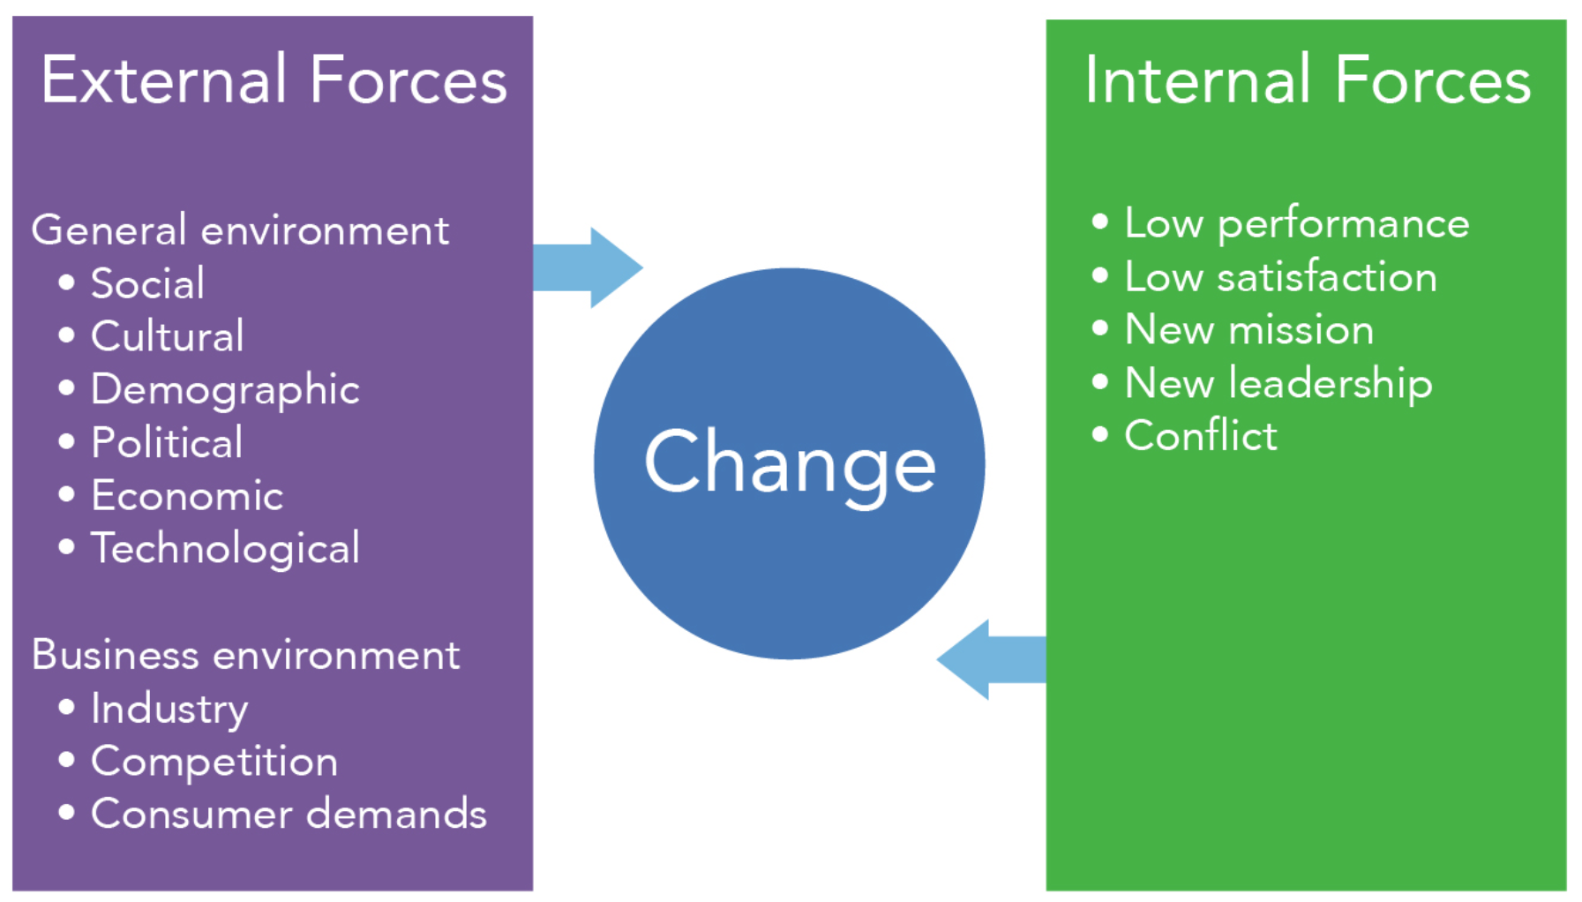
Forces of Change
Notes:
Image: Forces of Change. Provided by: Lumen Learning. License: CC BY: Attribution

Slide 6
Types of Change: Planned and Unplanned
Planned change
Unplanned change
Notes:
Idea Plan Action . Authored by: Gerd Altmann. Provided by: Pixabay. Located at: https://pixabay.com/illustrations/idea-plan-action-success-concept-1855598/. License: CC0: No Rights Reserved. License Terms: Pixabay License
Untitled. Authored by: ElisaRiva. Provided by: Pixabay. Located at: https://pixabay.com/illustrations/questions-demand-doubts-psychology-1922477/. License: CC0: No Rights Reserved. License Terms: Pixabay License

Slide 7
Types of Change: Evolutionary and Revolutionary
Evolutionary change
Revolutionary change
Notes:
Spring Tree Sapling . Authored by: lagnaage. Provided by: Pixabay. Located at: https://pixabay.com/photos/spring-tree-sapling-sprout-wood-3980594/. License: CC0: No Rights Reserved. License Terms: Pixabay License
Image: Untitled. Authored by: Tookapic. Provided by: Pexels. Located at: https://www.pexels.com/photo/painting-black-paint-roller-8614/. License: CC0: No Rights Reserved.

Slide 8
Change can effect…
Technology
Product or service
Administration and management
People or human resources
Notes:
Image: Untitled. Authored by: Robin Higgins . Provided by: Pixabay. Located at: https://pixabay.com/photos/upset-overwhelmed-stress-tired-2681502/. License: CC0: No Rights Reserved. License Terms: Pixabay License

Slide 9
Resistance to change
Organizational resistance
Group resistance
Individual resistance
Notes:
Stairs. Authored by: Gerd Altmann. Provided by: Pixabay. Located at: https://pixabay.com/illustrations/stairs-silhouettes-human-upward-70509/. License: CC0: No Rights Reserved. License Terms: Pixabay License

Slide 10
Class Activity: Stand Up and Cross Your Arms!
Everyone stand up and cross their arms. Feel good? Good!
Now cross your arms the other way. If you generally cross your right arm over your left, cross your left arm over your right, and vice versa.
How does that feel? Weird? Tricky?
Discuss amongst yourselves how you were resistant to that particular suggested change. Did you feel that way when you experienced a change at work or school?
Notes:
Untitled. Authored by: Brazilian Cyan. Provided by: Pixabay. Located at: https://pixabay.com/photos/brazil-roraima-glasses-model-kid-1368806/. License: CC0: No Rights Reserved. License Terms: Pixabay License

Slide 11
Ideas for Encouraging Change
Education and communication
Participation and involvement
Facilitation and support
Negotiation and agreement
Manipulation and cooperation
Explicit and implicit coercion
Notes:
Untitled. Authored by: bluebudgie. Provided by: Pixabay. Located at: https://pixabay.com/illustrations/whiteboard-blank-notice-message-4083244/. License: CC0: No Rights Reserved. License Terms: Pixabay License

Slide 12
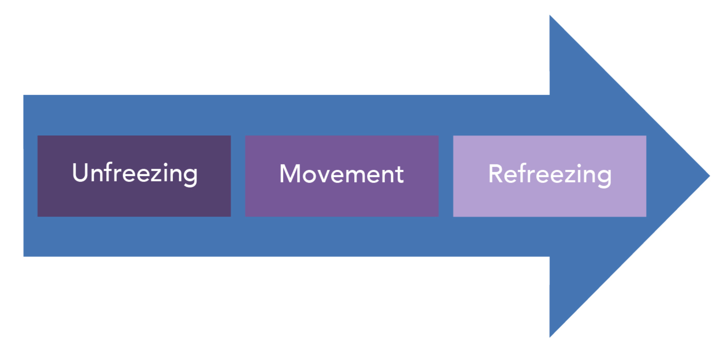
Lewin’s Three-Step Change Management Model
It emphasizes the importance of recognizing the need for change and being motivated to implement it.
It acknowledges that resistance to change is inevitable.
It focuses on people as the source of change and learning.
It highlights the need to support new behaviors.
Notes:
Image: Lewins Three-Step Model. Provided by: Lumen Learning. License: CC BY: Attribution

Slide 13
Kotter’s Eight-Step Plan for Implementing Change
a sense of urgency around change
a coalition for managing the change
a communicated vision for the change
the removal of obstacles to accomplishing change
the continued pursuit of change in spite of apparent victory
an anchoring of the changes into the organization’s culture
Notes:
Image: Kotter Eight Step Plan. Provided by: Lumen Learning. License: CC BY: Attribution

Slide 14
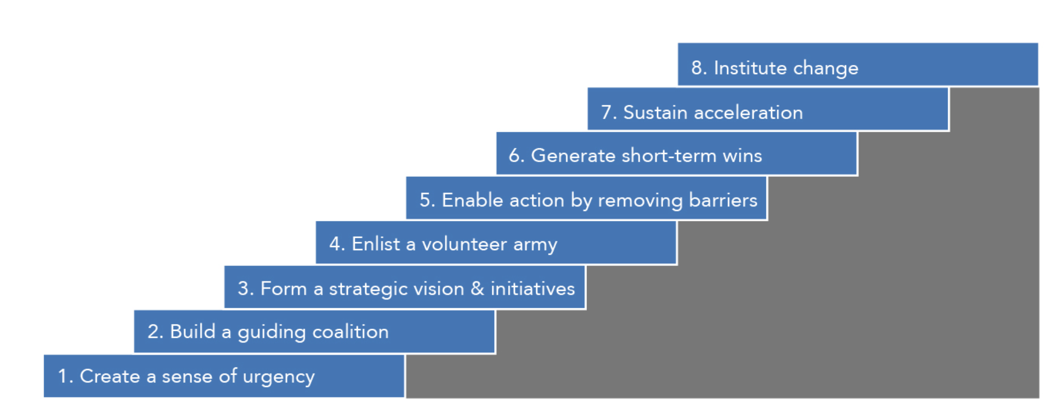
Figure: Kotter’s Eight-Step Plan for Implementing Change

Slide 15
Other Change Management Models
Nadler’s Change Management Model
Suggested that any change within an organization has a ripple effect to the other areas of the organization
Action Research
Data driven change management
Organizational Development
Attempts to solve organizational inertia with commitment to ongoing change
Crisis Management
The management of unplanned change

Slide 16
Practice Question 1
What is a characteristic of internal forces of change?
They’re social and cultural in nature
They are defined by low performance and economic downturn
They are outside of the company’s control
They’re often related to external forces
Notes:
Answer is D

Slide 17
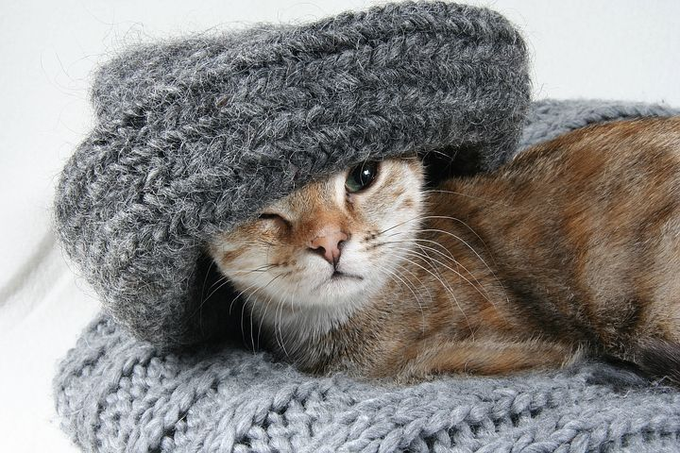
Class Discussion: Plan a Change
Your company currently manufactures hats for people. Now, you’re going to introduce a new line of hats for cats. Hats for Cats is a big change to your organization’s day-to-day work. You will need to plan for:
Manufacturing
Distribution
Marketing
Sales
Which change management process will you use to get Hats for Cats underway? Why? And whom will it affect?
Prepare a report and prepare to defend it.
Notes:
Instructor can listen to their plans, what change management process they will use, and poke holes as necessary.
Instructor can also shift around group participants so that the group has to explain their process to the newcomer(s) and get buy-in
Lucky Cat. Authored by: auenleben. Provided by: Pixabay. Located at: https://pixabay.com/photos/cat-lucky-cat-she-cat-kitten-2201460/. License: CC0: No Rights Reserved. License Terms: Pixabay License

Slide 18
Practice Question 2
Kotter’s eight step plan for managing change mirrored what other model of managing change?
Nadler’s system model
Lewin’s three step model
Action model
Organizational development
Notes:
Answer is B

Slide 19
Success and Failure in Change

Slide 20
Learning Outcomes: Success and Failure in Change
15.2: Discuss various ways change has succeeded and failed in contemporary examples and organizations
15.2.1: Discuss crisis management and process improvement
15.2.2: Discuss external change management and stimulating innovation
15.2.3: Discuss internal change management and learning organizations

Slide 21
Crisis Management and Process Reengineering
Issue: Volkswagen installed defeat software into their diesel engines so they would pass US emission testing, despite being otherwise non-compliant.
Volkswagen’s responses to change:
Reviewed distinctive competencies and elected to focus on electric cars post-crisis
Reviewed core processes to determine weaknesses
Reorganized around horizontal processes to support changes.
Volkswagen underwent process reengineering:
Reorganized horizontal processes to move away from top-down alignment
Put decision making back in the hands of experts
Working to change corporate culture

Slide 22
Process Reengineering and Continuous Process Improvement
Process Reengineering
Management starts with a clean sheet of paper and rethinks and redesigns the processes by which an organization does work and creates value.
Looks at
Distinctive competencies
Core processes
Reorganizing around horizontal processes
Continued process improvement to ensure organization is functioning at its highest capability

Slide 23
External Change Management and Stimulating Innovation
Issue: Borders Books and Music did not respond quickly enough to changes in their technological environment
Borders responses to change:
Gave ecommerce business away to Amazon as a means of outsourcing – took that business back in house too late
Invested in music when MP3 players were starting to emerge and become popular
Employees lacked technology to do their jobs
Borders lacked stimulating innovation:
Overseas investment left the company with no budget to bring innovation in house
Inflexible store leases, etc., prevented agility
Needed idea champions and a culture that permitted innovation.

Slide 24
Stimulating Innovation
Structural variables as a source
Organizations create cultures that stimulate innovation
Creating idea champions
Notes:
Lightbulb. Authored by: Free-Photos. Provided by: Pixabay. Located at: https://pixabay.com/photos/light-bulb-lightbulb-light-bulb-1246043/. License: CC0: No Rights Reserved. License Terms: Pixabay License

Slide 25
Internal Change Management and Learning Organizations
Issue: Amazon’s purchase of Whole Foods created a clash of cultures, where Amazon was very bureaucratic and Whole Foods was team-based and organic.
Amazon’s merger failures(so far):
Failure to merge cultures – Whole Foods expected to operate under the new Amazon system
Lack of buy-in from Whole Foods team
Creating competitive and reactive environment with bureaucratic employee assessments, etc.
Steps needed to make this work:
Employ double-loop learning to modify organizational objectives
Reduce fragmentation and, with it, reactiveness to reduce competition
Reestablish innovative environments

Slide 26
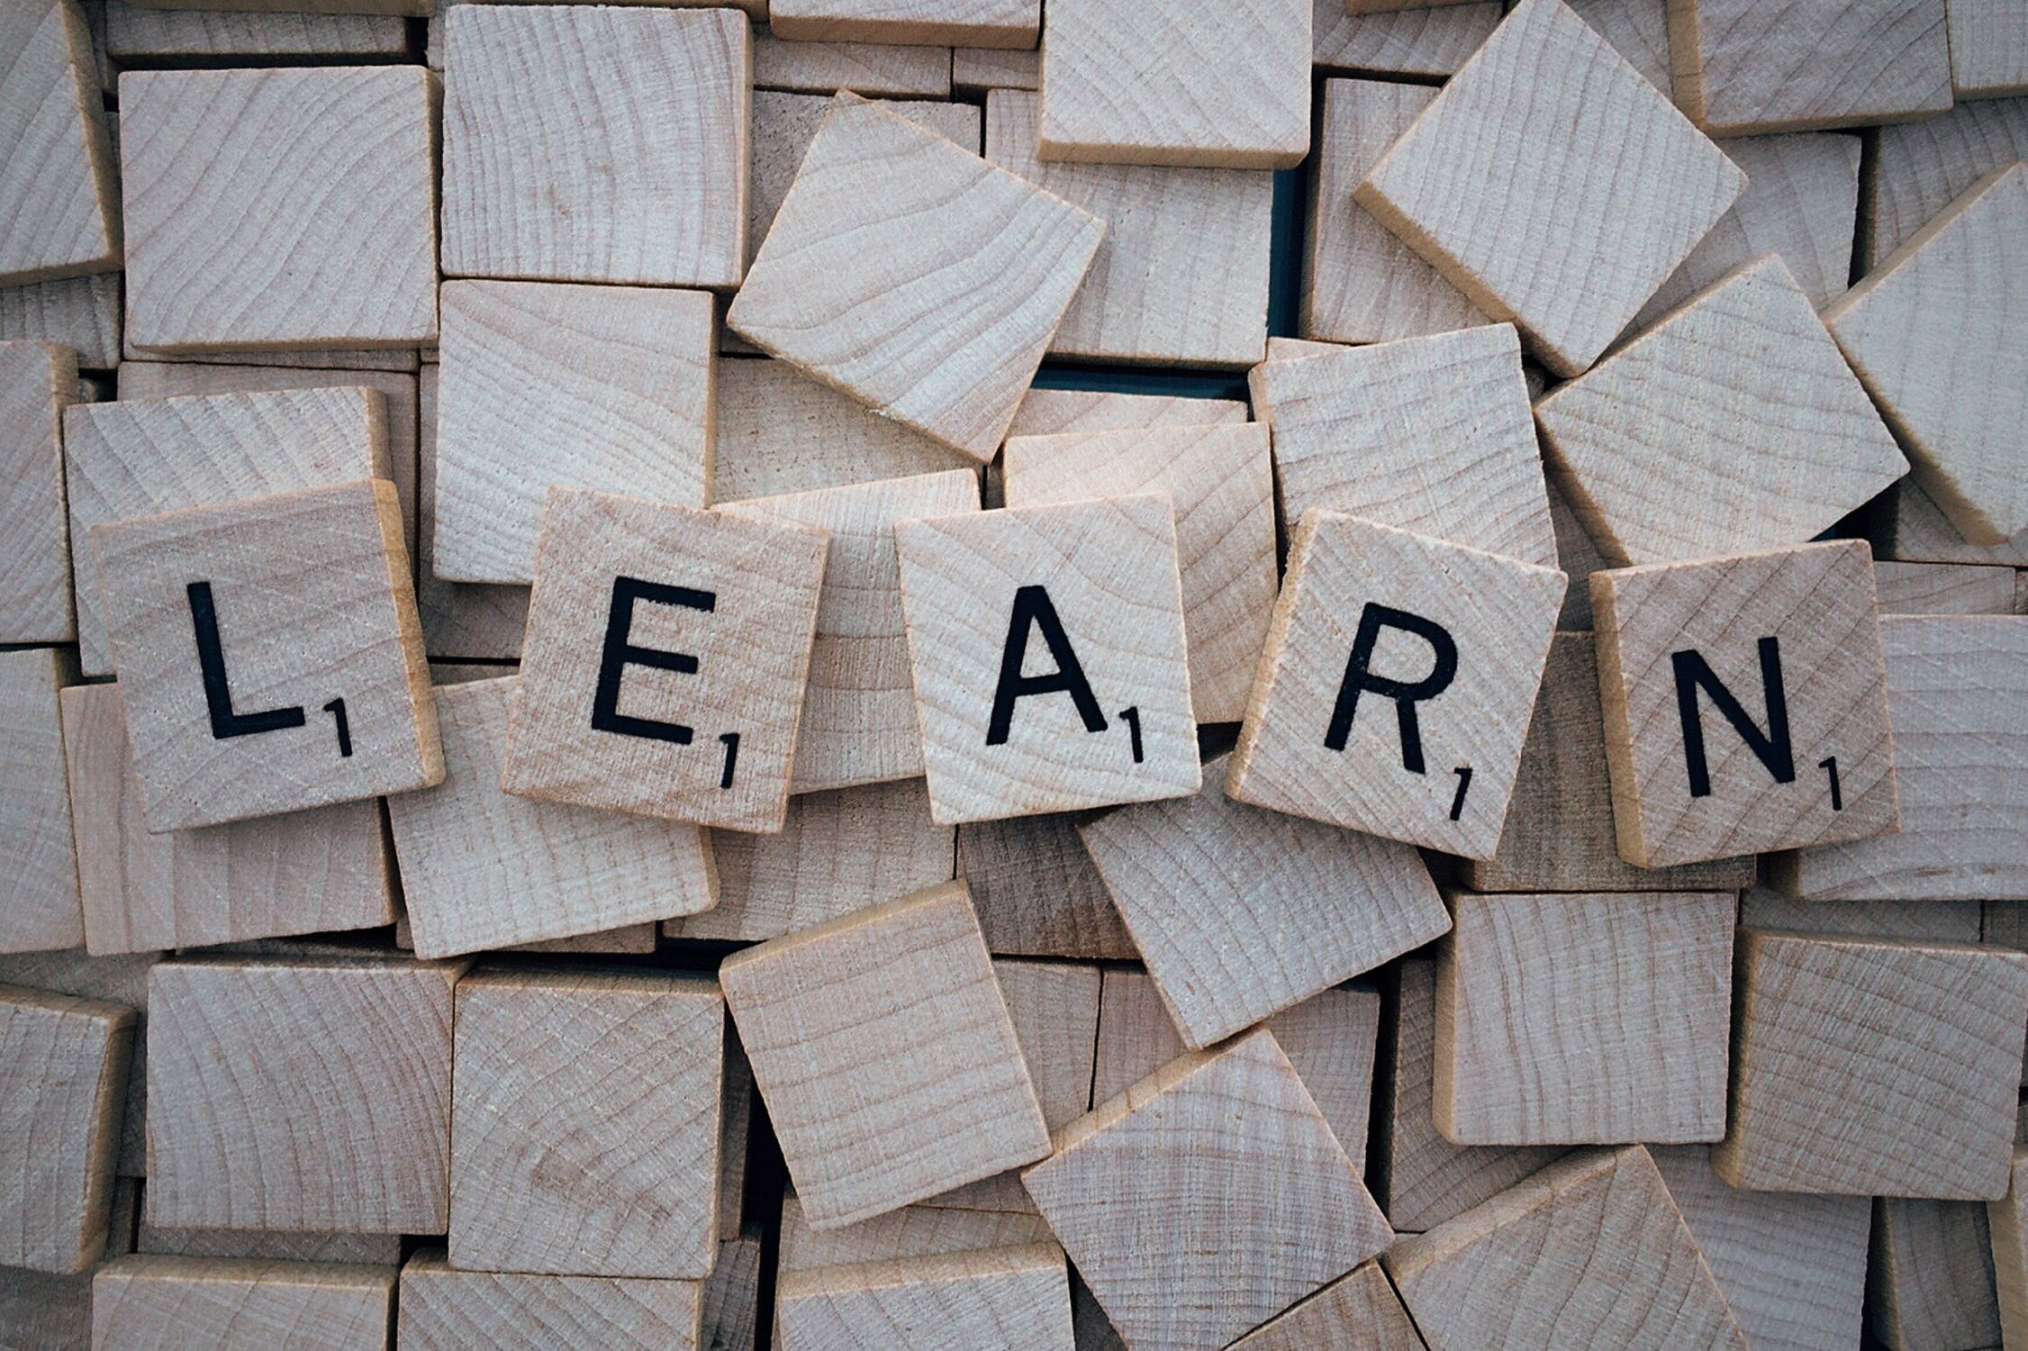
Learning Organizations
Learning organizations attempt to address fragmentation, competition and reactiveness because
There exists a shared vision upon which everyone agrees.
People discard old ways of thinking and standard routines.
Members think of all organizational processes, activities, functions and interactions with the environment as part of a system with interrelationships.
People openly communicate with each other across vertical and horizontal boundaries without fear of criticism or punishment.
Personal self-interests and fragmented departmental interests are sublimated to the organization’s shared vision.
Notes:
Letter blocks. Authored by: Pixabay. Provided by: Pexels. Located at: https://www.pexels.com/photo/letter-blocks-247819/. License: CC0: No Rights Reserved.

Slide 27
Practice Question 3
What process that organizations adopt and repeat regularly might have helped to prevent Shell’s issue?
Organizational development
Case improvement
Process reengineering
Crisis management
Notes:
Answer is C

Slide 28
Practice Question 4
Borders suffered the consequences when they didn’t anticipate their products moving to an electronic format. This is an example of what kind of change?
Economic change
Internal change
Social change
Technological change

Slide 29
Practice Question 5
A learning organization looks to remedy what three fundamental problems in traditional organizations?
Fragmentation, competition and reactiveness
Fragmentation, composition and reactiveness
Fragmentation, double loop learning and reactiveness
Double loop learning, competition and process change
Notes:
Answer is A

Slide 30
Quick Review
Forces of change can be external or internal
Change is planned or unplanned, and it’s either evolutionary or revolutionary
Change can effect technology, product or service, administration and management, or people or human resources
Resistance to change can be individual, group or even organization-wide, but education, communication and support can minimize issues
Many models exist to suggest how to introduce and manage change, including models by Kurt Lewin and John Kotter
Organizations adopt processes to minimize the effects of change, like
Process reengineering and continuous improvement
Stimulating innovation
Learning organization

