Slide 1
Organizational Behavior
Module 14: Organizational Structure
Notes:
Cover Image: "Untitled." Authored by: StartupStockPhotos. Provided by: Pixabay. Located at: https://pixabay.com/en/ideation-startup-entrepreneur-3267505/. Content Type: CC Licensed Content, Shared Previously. License: CC0: No Rights Reserved.
All text in these slides is taken from https://courses.lumenlearning.com/wmopen-organizationalbehavior/ where it is published under one or more open licenses.
All images in these slides are attributed in the notes of the slide on which they appear and licensed as indicated.

Slide 2
Module Learning Outcomes
Identify common organizational structures and the advantages and disadvantages of each
14.1: Describe the various organizational structures and their history
14.2: Identify the best structures for different types of organizations

Slide 3
Organizational Structures and Their History

Slide 4
Learning Outcomes: Organizational Structures and Their History
14.1: Describe the various organizational structures and their history
14.1.1: Discuss the elements of organizational structure
14.1.2: Discuss common organizational structures and their historical origins
14.1.3: Identify modern organizational design options

Slide 5
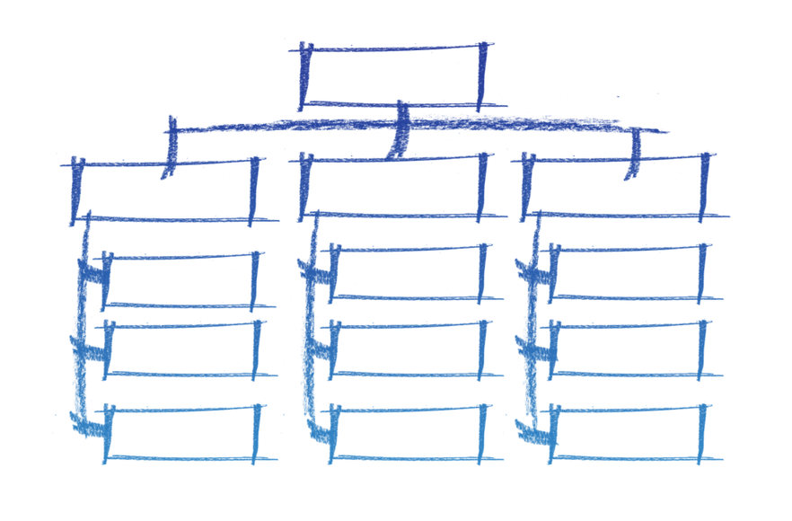
Components of an Organizational Structure
Work specialization
Departmentalization
Chain of command
Span of control
Centralization and decentralization
Formalization
Notes:
Organization Chart. Authored by: Gerd Altmann. Provided by: Pixabay. Located at: https://pixabay.com/illustrations/organization-chart-1989132/. License: CC0: No Rights Reserved. License Terms: Pixabay License

Slide 6
Types of Structures: Simple Structure
A low degree of departmentalization
Wide spans of control
Centralized authority
Little formalization
Notes:
Image: The Simple Structure. Provided by: Lumen Learning. License: CC BY: Attribution

Slide 7
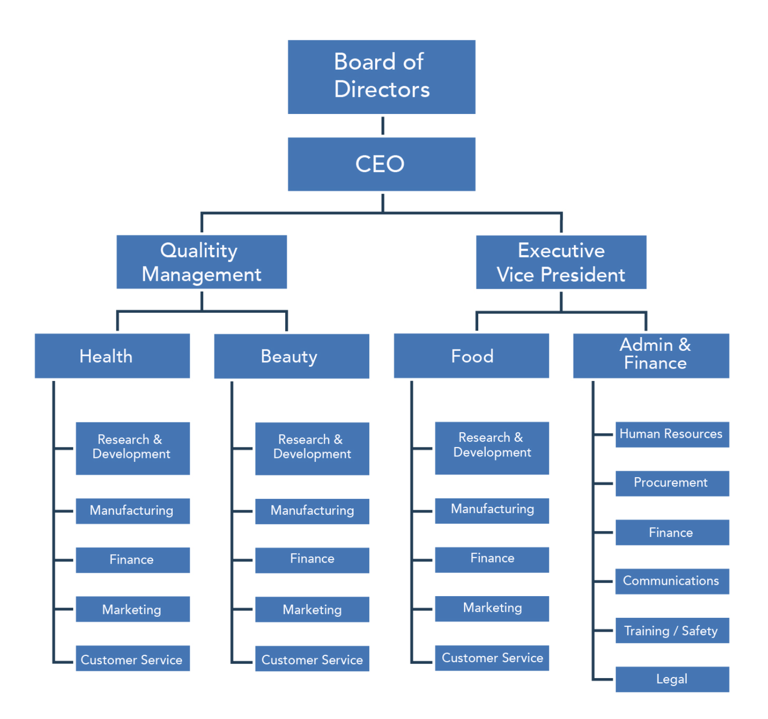
Types of Structures: Bureaucratic Structure
Highly routine operating tasks achieved through specialization
Very formalized rules and regulations
Functional departmentalization
Centralized authority
Narrow spans of control
Decision making that follows the chain of command
Notes:
Image: Bureaucratic Structure. Provided by: Lumen Learning. License: CC BY: Attribution

Slide 8
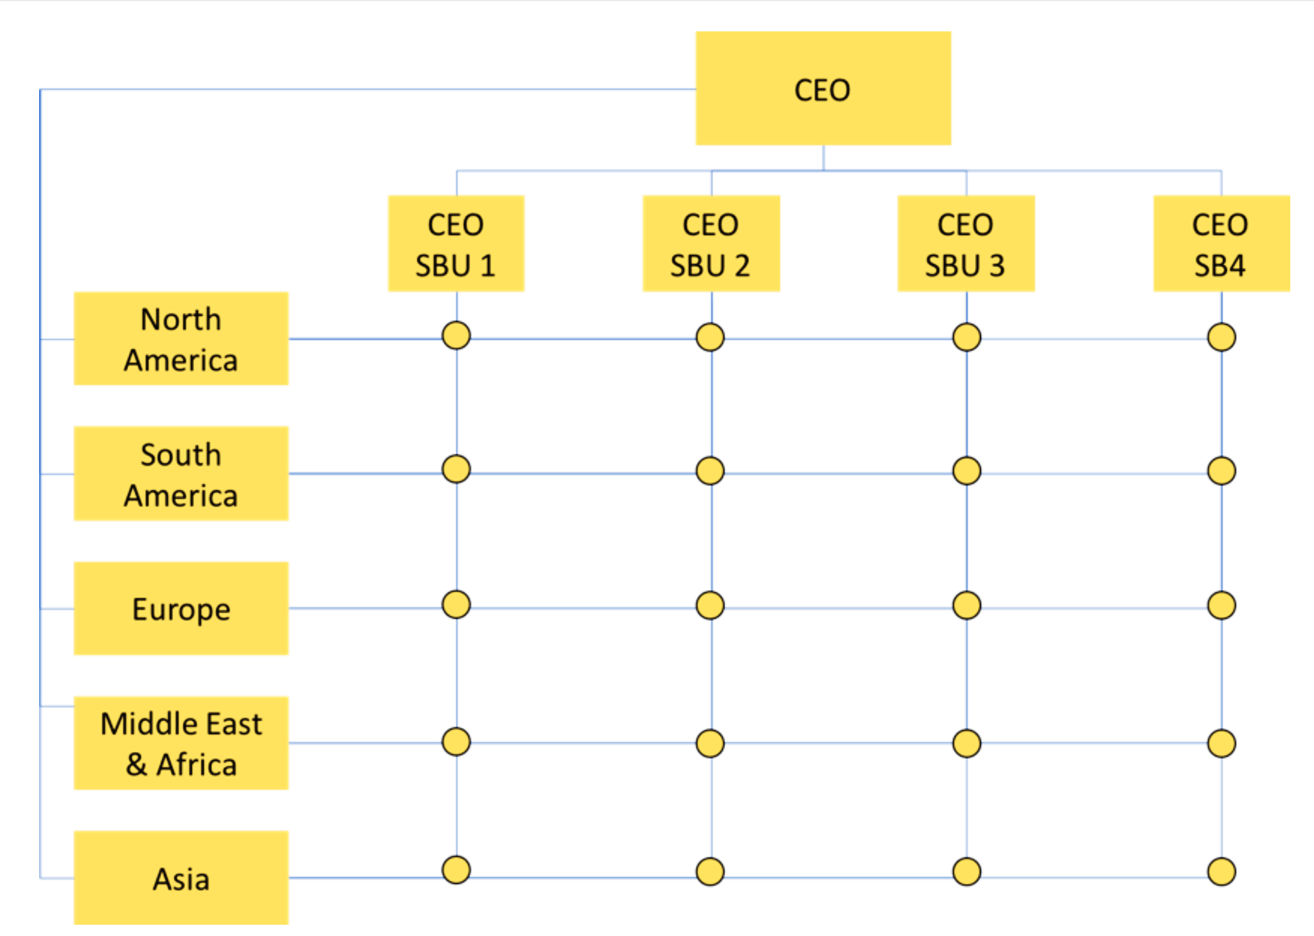
Types of Structures: Matrix Structure
Dual lines of authority
Combines functional and product departmentalization
Notes:
Image: Matrix Structure with Geographic and Product (SBU) Structure. Authored by: David J. Thompson, PhD, and Lumen Learning. Located at: https://courses.lumenlearning.com/wmopen-principlesofmanagement/chapter/common-organizational-structures/. License: CC BY: Attribution

Slide 9
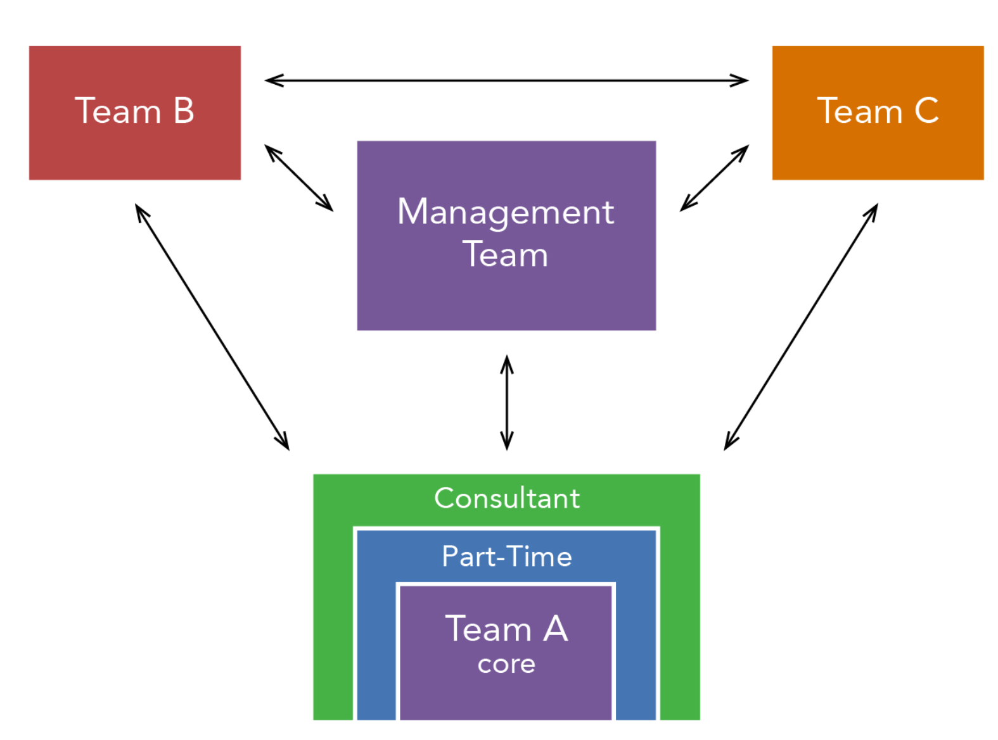
Modern Organizational Designs
Team Structure
Breaks down department barriers
Decentralizes decision making to the teams
Requires employees to be generalists rather than specialists
Notes:
Image: The Team Structure. Provided by: Lumen Learning. License: CC BY: Attribution

Slide 10
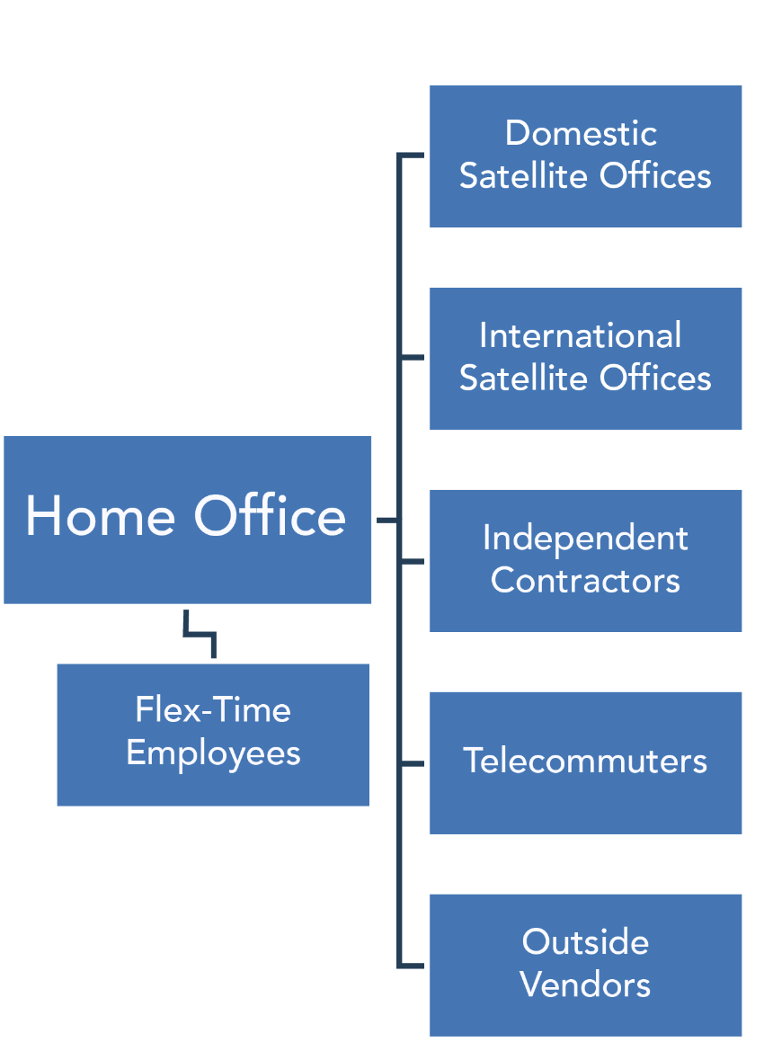
Modern Organizational Designs: Virtual Company Structure
Virtual Company Structure
Home office with flex-time employees, often working from home
Most functions of the company are outsourced
Notes:
Image: Virtual Organization. Provided by: Lumen Learning. License: CC BY: Attribution

Slide 11
Modern Organizational Designs: Boundaryless Organizations
Boundaryless Organizations
Eliminates vertical and horizontal boundaries between employees and between the company and vendors
Flattened organization
Cross-functional teams
Activities arranged around process
Often called the T-structure because it’s dependent on technology

Slide 12
Modern Organizational Designs: Holacracy™
Holacracy™
Authority and decision making distributed amongst self-organizing teams
Roles instead of job descriptions
Circle structure
Governance and operational processes
Notes:
hands. Authored by: rawpixel. Provided by: Pixabay. Located at: https://pixabay.com/en/man-people-achievement-african-3230661/. License: CC0: No Rights Reserved. License Terms: Pixabay License

Slide 13
Class Activity: Match the Structure to its Description
Bureaucratic
Holocracy
Boundaryless
Virtual
Simple
Matrix
Flat, sometimes called T-structure
Best for large organization
Small staff, outsources functions
Circular structure
Organized by both product and function
Small staff, all report to one leader
Notes:
A-2
B-4
C-1
D-3
E-6
F-5
connect. Authored by: Public Domain Pictures. Provided by: Pixabay. Located at: https://pixabay.com/illustrations/whiteboard-blank-notice-message-4083244/. License: CC0: No Rights Reserved. License Terms: Pixabay License

Slide 14
Practice Question 1
Organizations are more efficient if their span of control has what feature?
If it is taller
If each manager has only two or three subordinates
If it is flatter
If each manager has many subordinates doing very different jobs
Notes:
Answer is C

Slide 15
Practice Question 2
What are the benefits of a bureaucratic organizational structure?
It provides the ability to perform standardized tasks well
It’s extremely flexible and helps organizations respond to change
It allows efficient allocation of specialists
It allows for decentralized decision making
Notes:
Answer is A

Slide 16
Practice Question 3
An organization that looks to other companies to provide necessary services is referred to as a _____________.
Team-based organization
Bureaucratic organization
Holacratic organization
Virtual organization
Notes:
Answer is D

Slide 17
Choosing an Organizational Structure

Slide 18
Learning Outcomes: Choosing an Organizational Structure
14.2: Identify the best structures for different types of organizations
14.2.1: Discuss organic versus mechanistic models for organizational structure
14.2.2: Identify the factors that determine an organizational structure
14.2.3: Organizational structure and its impact on success

Slide 19
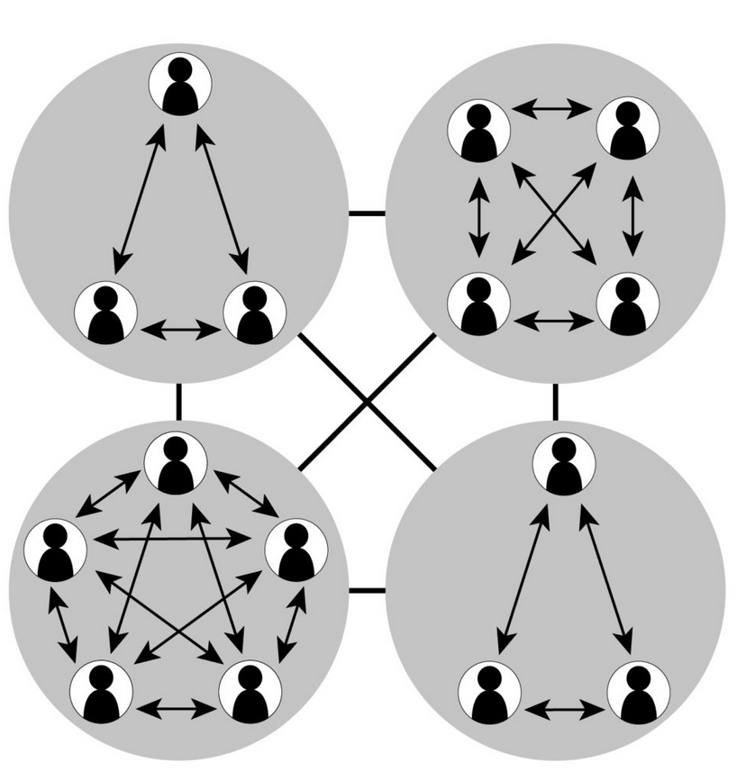
Organic Organizational Structures
General tasks
Loosely defined departments and hierarchy
Decentralized decision making by many individuals
Integration achieved by managers and employees interacting and exchanging information as needed
Flexibility and capability of rapid change
Notes:
Image: Organic Organizations. Provided by: Lumen Learning. License: CC BY: Attribution

Slide 20
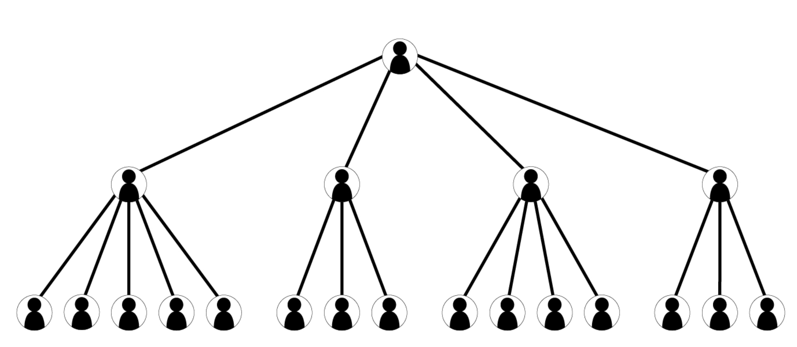
Mechanistic Structures
Specialized tasks
Well-defined departments with clear hierarchy
Centralized decision making by a few people
Integration achieved by formal manager meetings
Clear and efficient reporting relationships
Notes:
Image: Mechanistic Organizations. Provided by: Lumen Learning. License: CC BY: Attribution

Slide 21
Which Organizational Structure is Right?
Notes:
Checkmate Chess. Authored by: stevepb. Provided by: Pixabay. Located at: https://pixabay.com/photos/checkmate-chess-resignation-1511866/. License: CC0: No Rights Reserved. License Terms: Pixabay License
Untitled. Authored by: 3dman_eu. Provided by: Pixabay. Located at: https://pixabay.com/illustrations/giant-small-large-crush-fear-1013693/. License: CC0: No Rights Reserved. License Terms: Pixabay License
Cyber network. Authored by: TheDigitalArtist. Provided by: Pixabay. Located at: https://pixabay.com/illustrations/cyber-network-technology-futuristic-3400789/. License: CC0: No Rights Reserved. License Terms: Pixabay License
Image: Dimensions of Environmental Uncertainty. Provided by: Lumen Learning. License: CC BY: Attribution

Slide 22
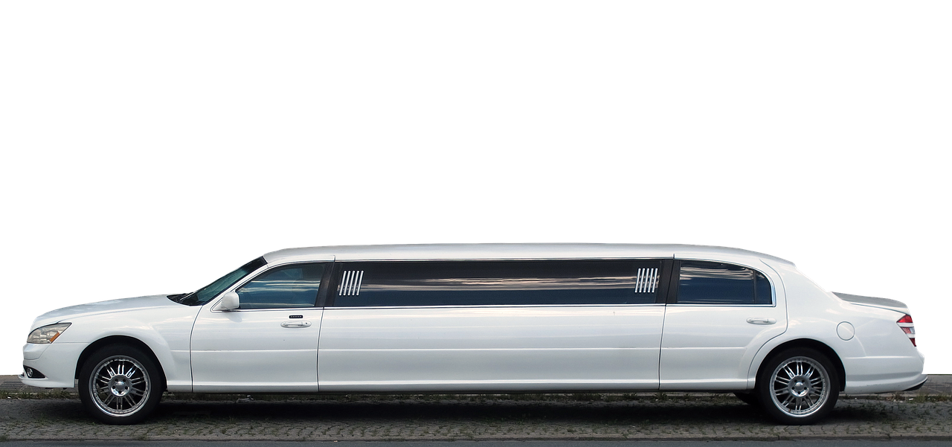
Individual Activity: Organize Your Company
You own a small ground transportation company, managing a fleet of 20 cars. You specialize in taking people to and from the airport. Currently you have:
22 part-time drivers
4 dispatchers/operations people
3 finance personnel
A human resources leader
An assistant
Do you need to hire or lay off anyone? Which organizational structure would you choose and why? Who reports to whom? Draw out your organizational structure.
Notes:
Mercedes Stretch Limo. Authored by: anaterate. Provided by: Pixabay. Located at: https://pixabay.com/photos/mercedes-stretch-limousine-2472988/. License: CC0: No Rights Reserved. License Terms: Pixabay License

Slide 23
Class Discussion: Organize Your Company
What does your organizational structure look like?
Why did you organize it that way?
Notes:
Encourage students to share their structures, but as a second option, create an organizational structure together.

Slide 24
Organizational Structure and Success
Organizations should alter their structures to maximize the value of organizational structure. The structure should:
Aids effective communication
Aids in performance evaluation
Increases efficiency
Unburdens employees from excess or redundant work
Provides faster and better decision making
Provides clear reporting and working relationships
Notes:
Untitled Image. Authored by: Startup Stock Photo. Provided by: Pexels. Located at: https://www.pexels.com/photo/person-in-blue-shirt-wearing-brown-beanie-writing-on-white-dry-erase-board-7368/. License: CC0: No Rights Reserved.

Slide 25
Practice Question 4
General Motors is a large company in a fairly stable environment. What kind of organizational structure might they opt for?
An organic structure
A holacratic structure
A team structure
A mechanistic structure
Notes:
Answer is D

Slide 26
Practice Question 5
Organization size has an effect on structure. If a structure is organic, what can we guess about the size of the organization?
We can guess that it’s a smaller organization
We can guess that it’s a larger organization
It could be either small or large
We cannot make a guess based on the information given
Notes:
Answer is A

Slide 27
Practice Question 6
What should the right organizational structure be able to do for a company?
Increase profitability
Strengthen working relationships
Aid in effective communication and improve decision making
Allow employees to do more work than is needed
Notes:
Answer is C

Slide 28
Quick Review
Organizational structures look at various facets of the organization and how they should be controlled (decision making, span of control, etc.)
There are various organizational structures that help an organization organize to be productive and profitable
Organizational structures are either organic (flexible and flat) or mechanistic (formal and controlled)
Strategy, size, technology and industrial environment should be considered when structuring an organization

