Slide 1
Computer Applications for Managers
Microsoft Access Advanced Skills
Notes:
Cover Image: "Untitled Image." Authored by: Christin Hume. Provided by: Unsplash. Located at: https://unsplash.com/photos/mfB1B1s4sMc. Content Type: CC Licensed Content, Specific Attribution. License: CC0: No Rights Reserved. License Terms: Unsplash License.
All text in these slides is taken from https://courses.lumenlearning.com/wm-computerapplicationsmgrs/ where it is published under one or more open licenses.
All images in these slides are attributed in the notes of the slide on which they appear and licensed as indicated.

Slide 2
Module Learning Outcomes
Perform advanced tasks in Microsoft Access
14.1: Import and export data
14.2: Create and modify queries
14.3: Use forms and reports
14.4: Analyze data

Slide 3
Importing and Exporting Data

Slide 4
Learning Outcomes: Importing and Exporting Data
14.1: Import and Export Data
14.1.1: Discuss the value of external data
14.1.2: Differentiate among import and export options
14.1.3: Import external data
14.1.4: Export data

Slide 5
External Data
Business data stored many places.
External data can be tricky.
External data usually stored in different applications and formats.
Access can use data:
Oracle
SQL Server
Other ODBC compliant DBs
Excel
XML
HTML
Word documents
Text files

Slide 6
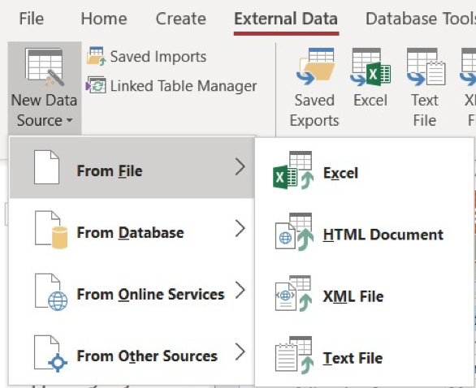
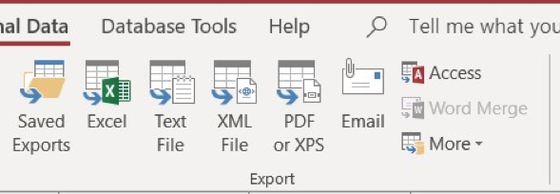
Import and Export Options
Importing
External Data > New Data Source
From File
Excel, HTML Doc, XML File, Text File
From Database
From Online Services
From Other Sources
Exporting
External Data > Export
Select from
Saved exports
Excel, Text File,
XML, PDF or XPS
Email
Access
Word Merge
More

Slide 7
Queries

Slide 8
Learning Outcomes: Queries
14.2: Create and modify queries
14.2.1: Define queries in Microsoft Access
14.2.2: Create a query
14.2.3: Add criteria to a query
14.2.4: Save queries

Slide 9
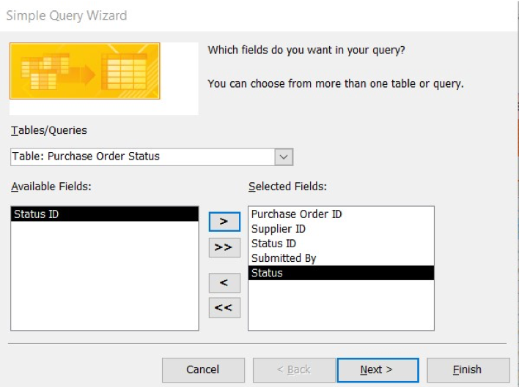
Understanding Queries
Access query
Ability to extract information from a database useful for decision-making.
Create a query
Create > Query Wizard
Simple Query Wizard
Crosstab Query Wizard
Find Duplicates Query Wizard
Find Unmatched Query Wizard

Slide 10
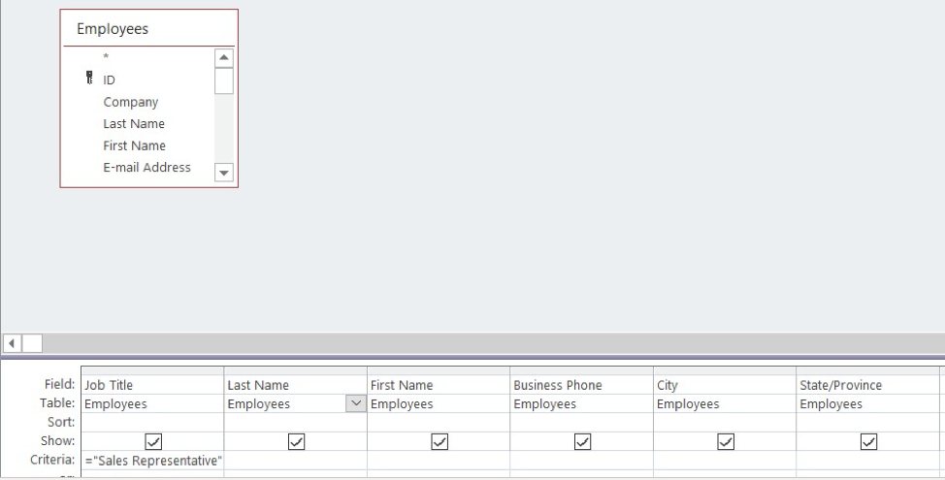
Adding Criteria to a Query
Database Designer for more complex queries
Include or exclude data elements.
Run query.

Slide 11
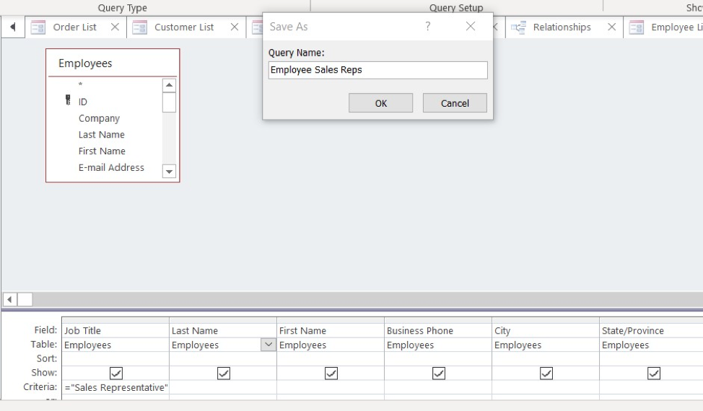
Saving Queries
Save a query
File > Save As
Enter query name

Slide 12
Practice Question 1
Zander just imported an Excel customer contact table into Access. He now wants to clean up the data a bit. He knows he can run a query to help eliminate customer information copies. Which query should Zander run to clean up his data?
Find Unmatched Query Wizard
Crosstab Query Wizard
Find Duplicates Query Wizard
Simple Query Wizard
Notes:
The correct answer is C.

Slide 13
Forms and Reports

Slide 14
Learning Outcomes: Forms and Reports
14.3: Use forms and reports
14.3.1: Define forms in Microsoft Access
14.3.2: Create basic forms
14.3.3: Compare different form controls and views
14.3.4: Present data on reports

Slide 15
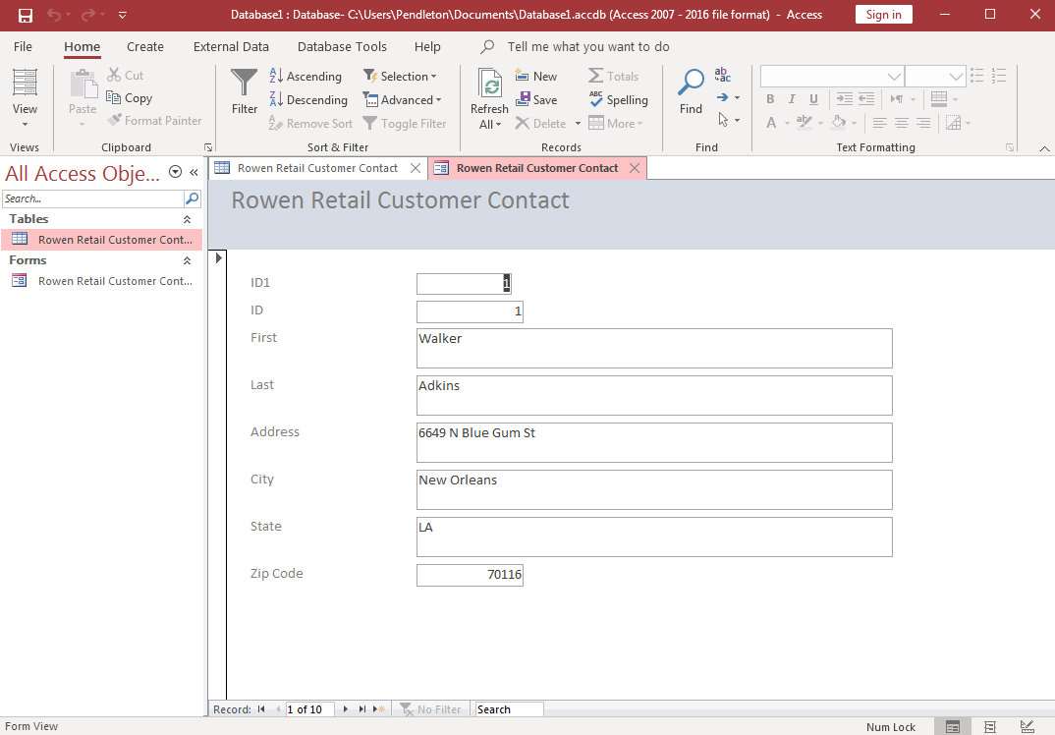
Understanding Forms and Reports
Access forms:
An object window to see database data.
Used for user interfaces to enter or manipulate data.

Slide 16
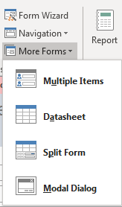
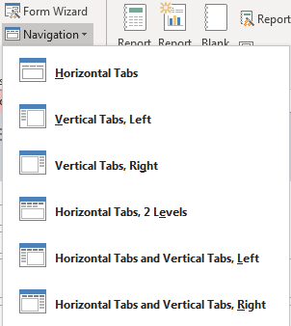
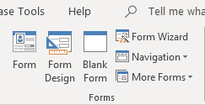
Creating Basic Forms
Basic Form
Select table or query
Create tab > Forms group > Form
Select Wizard or Form

Slide 17
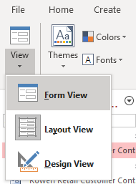
Form Controls and Views
Two view to modify forms and controls
Layout view
Most comprehensive way to change form.
Live form in layout view.
Design view
Used for detailed structure aspects.
Header, Detail and Footer
Not a live form – can’t see data effects.

Slide 18
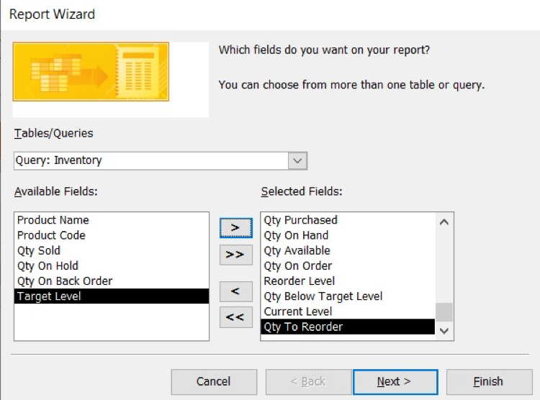
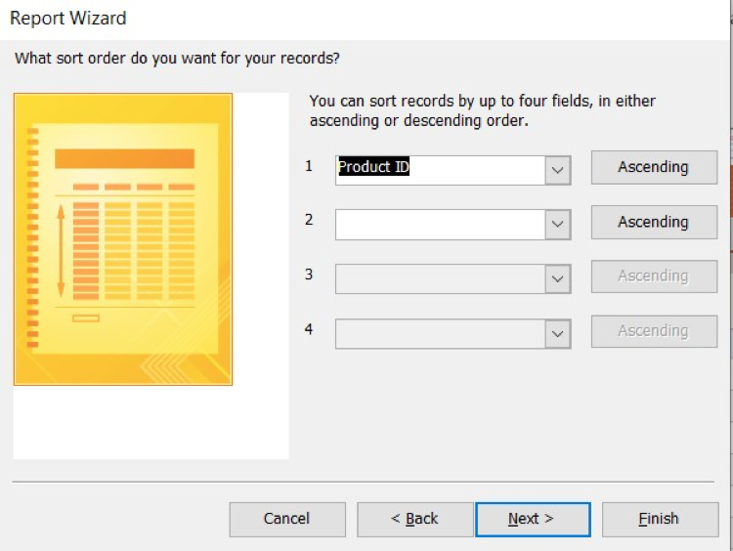
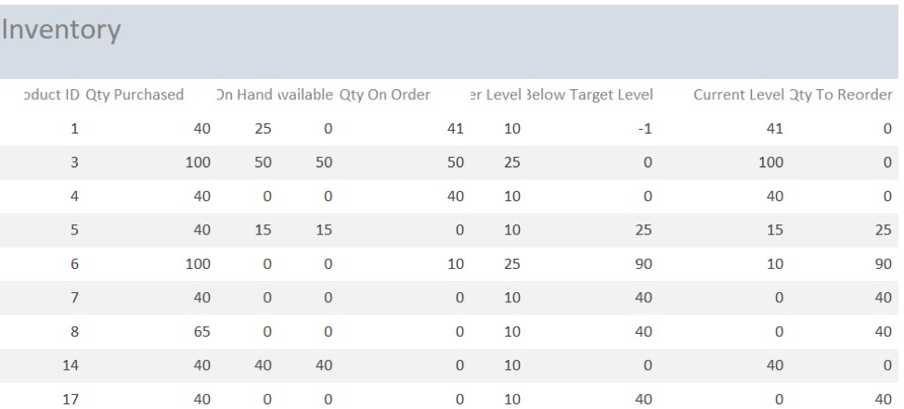
Presenting Data on Reports
Reports are for output
Primary way users consume information
Use Report Wizard
Report

Slide 19
Analyzing Data

Slide 20
Learning Outcomes: Analyzing data
14.4: Analyze data
14.4.1: Transform data
14.4.2: Discuss the use of calculations in Microsoft Access
14.4.3: Use conditional analysis
14.4.4: Use subqueries
14.4.5: Discuss domain aggregation

Slide 21
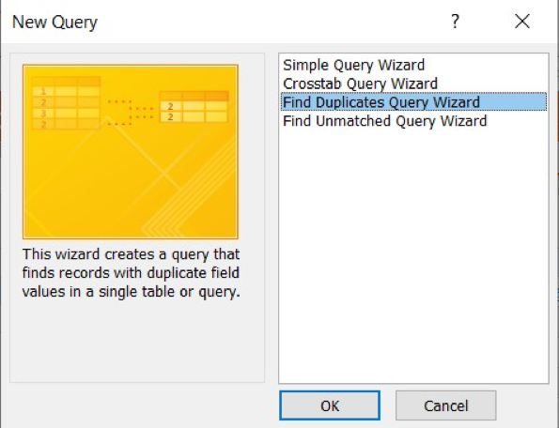
Transforming Data
Preparing data to use in database.
Duplicates
Missing fields
Concatenated strings
Etc.
Scrubbing data

Slide 22
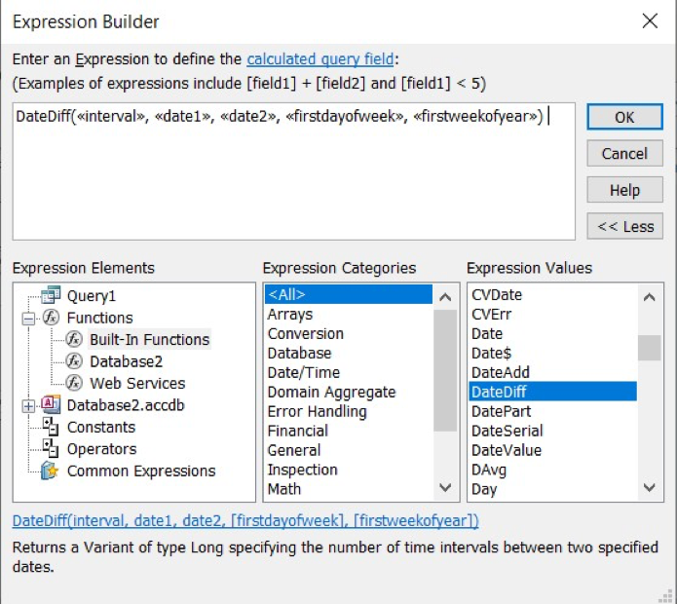
Understanding Calculations
Expression Builder
Rich set of functions;
Calculations;
Expressions for data analysis

Slide 23
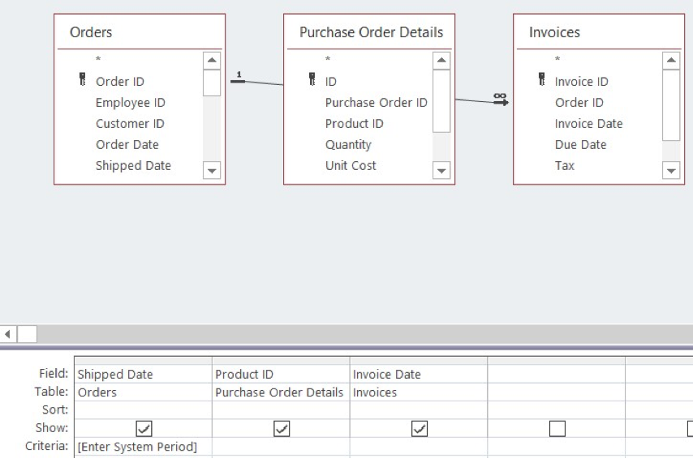
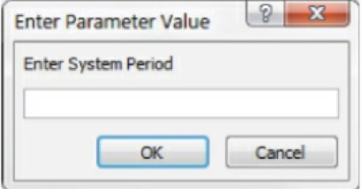
Using Conditional Analysis
Used when basis of analysis is in flux or may need to change.
Using parameter queries to deal with these changes.
Example: Various date ranges

Slide 24
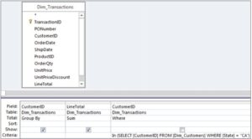
Using Subqueries
Query nested within another query
Like a question from another question’s answer
Subqueries require basic SQL knowledge
Relational Databases using SQL
Oracle Database
Microsoft SQL Server
MySQL
IBM DB2
IBM Informix
Microsoft Access
SQL Example
USE SW CREATE TABLE PROJECT ( ProjectID Int NOT NULL IDENTITY (1000,100), ProjectName Char(50) NOT NULL, Department Char(35) NOT NULL, MaxHours Numeric(8,2) NOT NULL DEFAULT 100, StartDate DateTime NULL, EndDate DateTime NULL, CONSTRAINT ASSIGNMENT_PK PRIMARY KEY(ProjectID) );

Slide 25
Understanding Domain Aggregation
Twelve Aggregate Functions extract and group data in larger data sets.
DSum
DAvg
DCount
DLookup
DMin and DMax
DFirst and DLast
DStDev
DStDevP
DVar
DvarP
FunctionName( “ [Field Name] “,” [Dataset Name] “, “[Criteria] “ )

Slide 26
Practice Question 2
Theo needs to pull out information from the company database of products and be able to present it to his boss. What does he need to created in order to print out what he is looking for in the database?
Query
Form
Report
Product Tables
Notes:
The correct answer is C.

Slide 27
Class Discussion: Expression Builder
In this course you have discovered Access can calculate functions like Excel and run various formulas in a database. If you haven’t looked closely at the expression builder do so now. Explore the variety of available formulas and discuss these questions with a few of your fellow classmates:
Expression Builder Questions
Does the expression builder seem intuitive to you? If not, why not?
Which functions in the builder are familiar because of Excel? Name a few.
How would you use the expression builder in a database?
What types of business examples can you think of where the expression builder would be useful?

Slide 28
Class Activity: Form Data Entry
For the last time, let’s use the Movie database and created a form to enter more movie information into this database. Follow the instructions after getting in a group of 3-4 people, then answer the questions below.
Instructions:
Open Movie database > Open Movie table
Click Create tab > Form button
New form is created from Movie table.
Navigate to last record in form (bottom left).
Add in five new movie records.
Save table.
Share your findings with your classmates.
Questions:
Did you find doing this activity easy or difficult? Why?
Did the form make it an easier experience to enter new information?
What other examples can you think of where a form would assist data entry for a database?
What questions arose as you did this activity?

Slide 29
Quick Review
Can you identify external data, import and export options?
How to you import external data and export Access data?
What are queries and how can they assist you?
How can you create a query?
How can you add criteria and save and print a query?
What are the differences between forms and reports?
Are you able to create a basic form?
Can you change the form views and use form controls?
How can you present data in a report?
How do you transform data?
Do you understand calculations and conditional analysis?
Can you use subqueries and understand domain aggregation?

