Slide 1

Computer Applications for Managers
Microsoft Access Basic Skills
Notes:
Cover Image: "Untitled Image." Authored by: Christin Hume. Provided by: Unsplash. Located at: https://unsplash.com/photos/mfB1B1s4sMc. Content Type: CC Licensed Content, Specific Attribution. License: CC0: No Rights Reserved. License Terms: Unsplash License.
All text in these slides is taken from https://courses.lumenlearning.com/wm-computerapplicationsmgrs/ where it is published under one or more open licenses.
All images in these slides are attributed in the notes of the slide on which they appear and licensed as indicated.

Slide 2
Module Learning Outcomes
Perform basic tasks in Microsoft Access
12.1: Create database tables
12.2: Working with fields
12.3: Setting table primary key
12.4: Create indexes

Slide 3
Creating Database Tables

Slide 4
Learning Outcomes: Creating Database Tables
12.1: Create database tables
  12.1.1: Create a blank database
  12.1.2: Name the database and location
  12.1.3: Discuss the role of tables in Access
  12.1.4: Differentiate among types of tables
  12.1.5: Create a new table

Slide 5
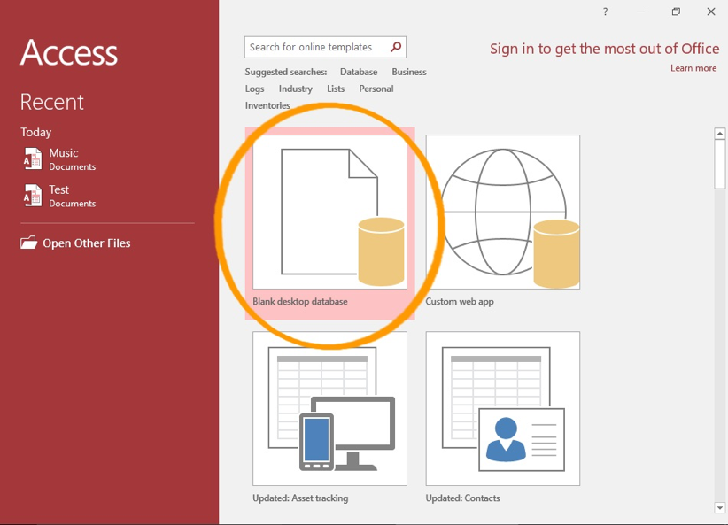
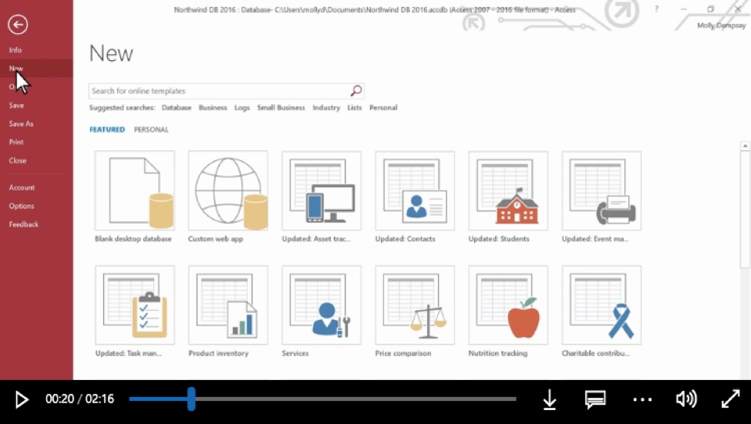
Blank Database
Method 1
Create Blank Database
Method 2
New > Blank desktop database

Slide 6
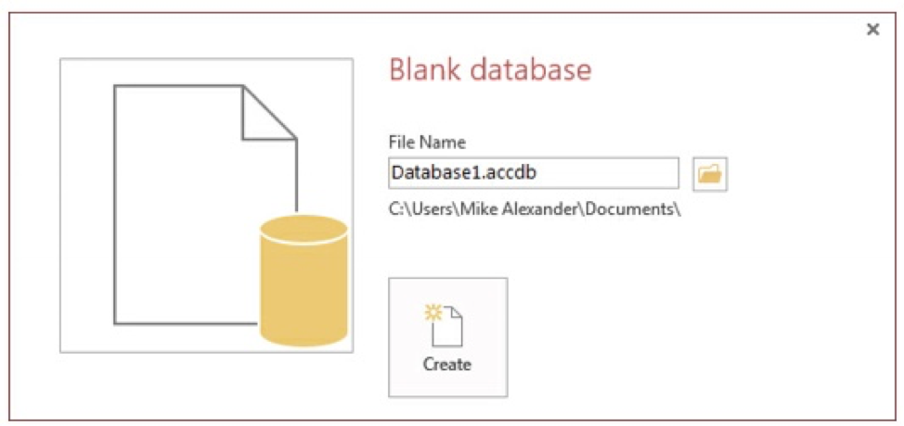
Name Database and Location
Name in File Name field
Select location to save
Create button

Slide 7
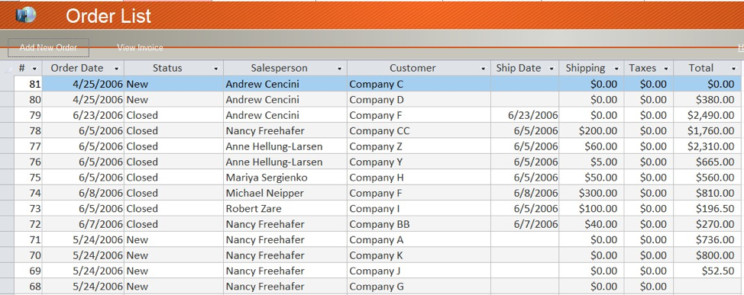
Role of Tables
Key object
  Store data
  Create one table per type of information
  Examples: customer information, products, order details

Slide 8
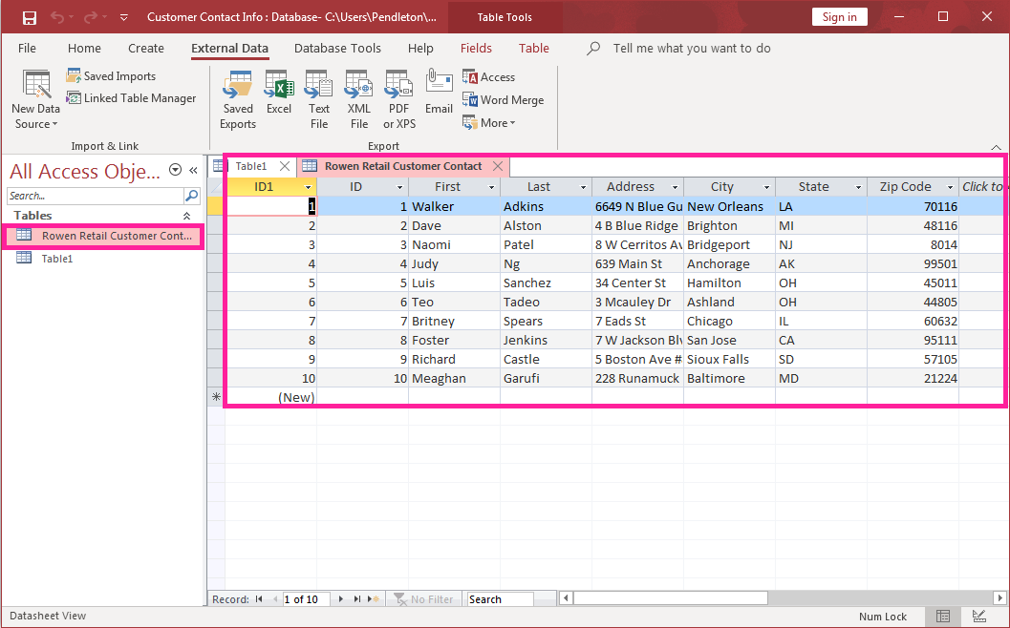
Differentiate Types of Tables
Three Table Types
  Object table
  Transaction table
  Join table

Slide 9
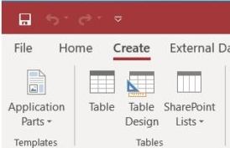
New Table
Create a New Table
  Create > Tables Group > Table button

Slide 10
Fields in Access

Slide 11
Learning Outcomes: Fields in Access
12.2: Working with fields
  12.2.1: Differentiate among field properties
  12.2.2: Discuss field name requirements
  12.2.3: Discuss types of data used in Microsoft Access

Slide 12
Field Properties
Field Properties: Sets boundaries on what/how is entered into table fields
Field Size: sets the maximum number of characters that can be entered into a text field.
Format: sets how the data is to be displayed in the table field.
Input Mask: sets the rules as to how data can be entered so that data is entered correctly.
Default Value: sets the default value that will appear in the table field each time a new record is entered.
Required: sets whether a value is required to be entered into this table field.

Slide 13
Field Name Requirements
Field names
  Descriptive to identify purpose of field
  To ensure valid field name:
    Cannot exceed 64 characters,
    Cannot include periods (.), exclamation points (!), accent grave (`), or brackets ([]),
    Cannot include spaces,
    Cannot include low-order ASCII characters,
    Cannot start with a blank space.

Slide 14
Data Types
Data Type | Description
Short text | Alphanumeric characters
Long text | Alphanumeric characters
Number | Numeric values
Large Number | Numeric values
Date/Time | Date and time data
Currency | Monetary data
AutoNumber | Automatic number increments
Yes/No | Logical values: Yes/No, True/False, etc.
OLE Objects | Pictures, graphs, sound, video
Hyperlink | Line to an Internet resource
Attachment | External files
Calculated | Stores calculations based on other fields
Lookup Wizard | Displays data from another table
Must be consistent with the data to be stored in the field.

Slide 15
Practice Question 1
What is it in Access that sets boundaries on how/what data is entered into table fields?
  Tables
  Datasheets
  Field Properties
  Size of table in Access
Notes:
The correct answer is C.

Slide 16
Table Primary Key

Slide 17
Learning Outcomes: Table Primary Key
12.3: Setting table primary key
  12.3.1: Discuss the importance of primary key uniqueness
  12.3.2: Chose a primary key
  12.3.3: Set the primary key

Slide 18

Primary Key Uniqueness
Every table must have a primary key
Is one or more fields uniquely identify each record
Example: ID number, serial number, or a code.

Slide 19

Chose a Primary Key
Need strong primary key to support good database engine performance:
Good primary keys must:
  Uniquely identify each record,
  Not be null,
  Exist when the record is created,
  Must remain stable,
  Be simple and contain as few attributes as possible.

Slide 20
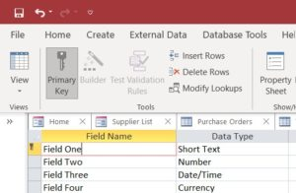
Set the Primary Key
Three ways to set primary key
Design view
  With the field to be used as the primary key selected, click the Primary Key button key in the Tools group.
  Right-click the appropriate field and choose Primary Key from the shortcut menu.
  Allow Access to automatically create the primary key by simply saving the table.

Slide 21
Indexes

Slide 22
Learning Outcomes: Indexes
12.4: Create Indexes
  12.4.1: Define indexes
  12.4.2: Set the properties of indexes
  12.4.3: Determine when to use an index

Slide 23

Understanding Indexes
Index Definition:
Data structure designed to improve the speed of data retrieval.
Index Properties
Indexes in Access have properties too.
  Primary. This property, when set to Yes, tells Access to use it as the table’s primary key.
  Unique. This property requires that the index is unique within the table.
  Ignore Nulls. If the index field of a record contains a null value, Access does not know how to handle the record. This property tells Access to ignore such records.
Notes:
What is an Index?. Authored by: Robert Danielson. Provided by: Lumen Learning. License: CC BY: Attribution

Slide 24
When to Use an Index
Advantages: Improves speed of data retrieval
  Larger tables
  Tables frequently queried
Drawbacks:
  Adds metadata to database.
  Increases size and disk space requirements.
  New record is added to an indexed table, there is a slight performance hit
    For 20 indexes on a table, Access will make 20 adjustments when a new record is added or subtracted.
  Avoid indexing on smaller tables or tables not frequently queried.

Slide 25
Practice Question 2
Yazmin has a large database filled with many records and fields. She needs to speed up the return time for her queries. How does she make her database ‘faster’?
  Adds more types of field properties.
  Adds indexes to her database.
  Resets the primary key.
  Adds more data to database.
Notes:
The correct answer is B.

Slide 26
Class Discussion: Database vs Excel
This first module on Access has given you a beginning idea how to create a database. Some of the examples used were for customer contact information, product data, sales number, etc. In previous modules, Excel was shown to do similar things as an Access database and even looks similar in some regards. Think about and discuss the next questions with your classmates.
Discuss the following:
    Do you think you will use Access or Excel more frequently? Why?
    What are the benefits to setting up and using an Access database?
    What are more examples of when databases are used in business?
    How can you create a database and keep it updated with current data?
    What questions do you have about databases? How can you find the answers?
Notes:
Title: Mac OS X. Authored by: Isaac Weiss. Located at: https://musescore.org/en/node/47361 License: CC-BY

Slide 27
Class Activity: Create Movie Database
This activity is to create a simple movie database of classmates’ favorite movies. Follow the instructions and at the end you will have a movie database.
Instructions
  Get into groups of 6–8.
  Open Access > Create blank database > Rename new table to Movies
  Go around group and ask for one or two of their favorite movies >
  In the ID think of a relevant ID name and enter it
  In first field after ID select field type > enter movie title
  Continue until 20+ movies are listed > Save, keep to be used in the next module’s activity
Questions to ask afterwards:
  Did you find doing this activity easy or difficult? Why?
  What types of problems did you run into making this database?
  What types of insights did you discover by making this database?
Share your findings with your classmates.

Slide 28
Quick Review
Can you create a blank database, name it and save it on your computer?
Are you able to talk about the role of tables in Access?
Can you differentiate among types of tables?
How do you create a new table?
Do you understand field properties?
Can you define field names and data types?
What is a primary key?
How do you choose a primary key and set one?
Do you understand indexes?
Can you set the properties of indexes?
Can you determine when to use and index?

