Slide 1
Computer Applications for Managers
Microsoft Excel Basic Skills
Notes:
Cover Image: "Untitled Image." Authored by: Christin Hume. Provided by: Unsplash. Located at: https://unsplash.com/photos/mfB1B1s4sMc. Content Type: CC Licensed Content, Specific Attribution. License: CC0: No Rights Reserved. License Terms: Unsplash License.
All text in these slides is taken from https://courses.lumenlearning.com/wm-computerapplicationsmgrs/ where it is published under one or more open licenses.
All images in these slides are attributed in the notes of the slide on which they appear and licensed as indicated.

Slide 2
Module Learning Outcomes
Perform Basic Tasks in Microsoft Excel
6.1: Create a worksheet and add data
6.2: Change formatting, layout, and styles in Excel
6.3: Create a new workbook with more than one worksheet

Slide 3
Using Excel

Slide 4
Learning Outcomes: Using Excel
6.1: Create a worksheet and add data
6.1.1: Create a new Excel workbook
6.1.2: Add data to a table

Slide 5
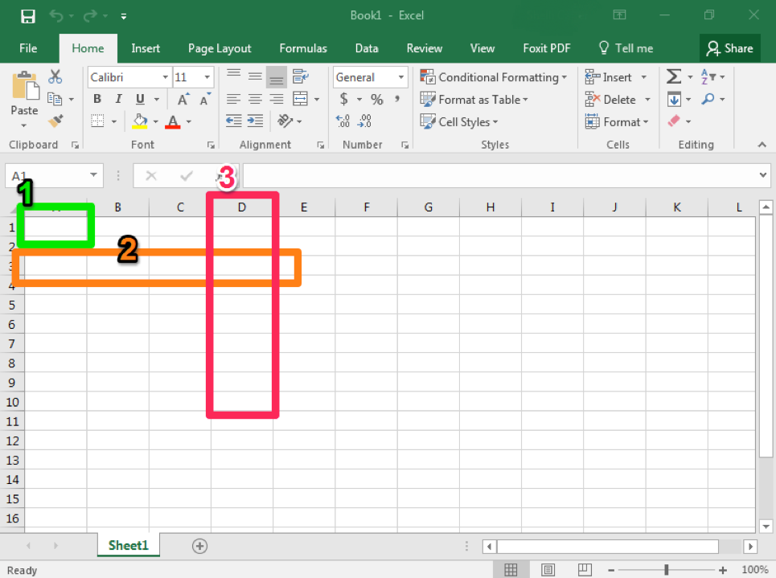
Creating a New Workbook
Open from Start menu- always has letter X and is green
Create new document just like Microsoft Word
Key terms
Cell (1)
Row (2)
Column (3)

Slide 6
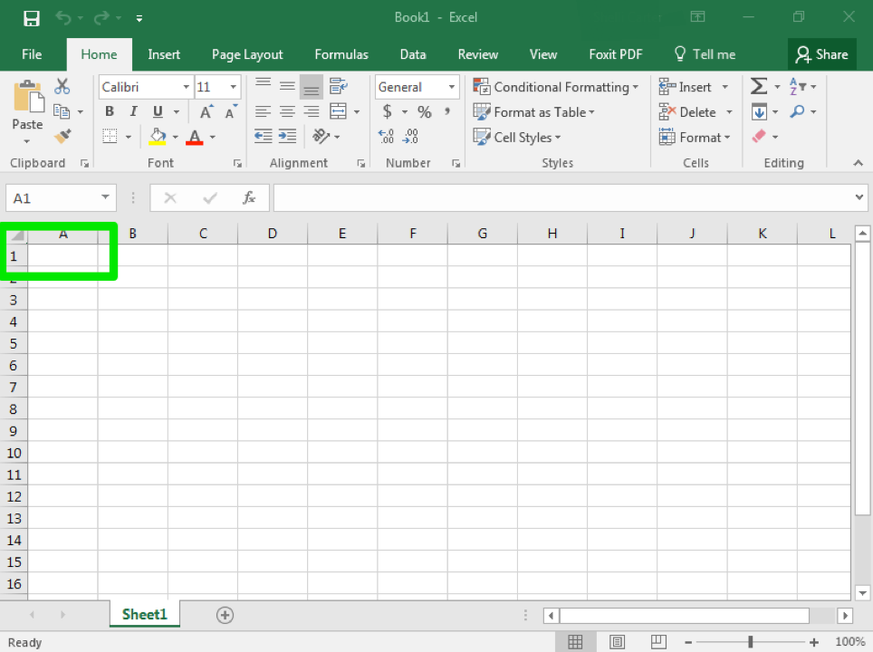
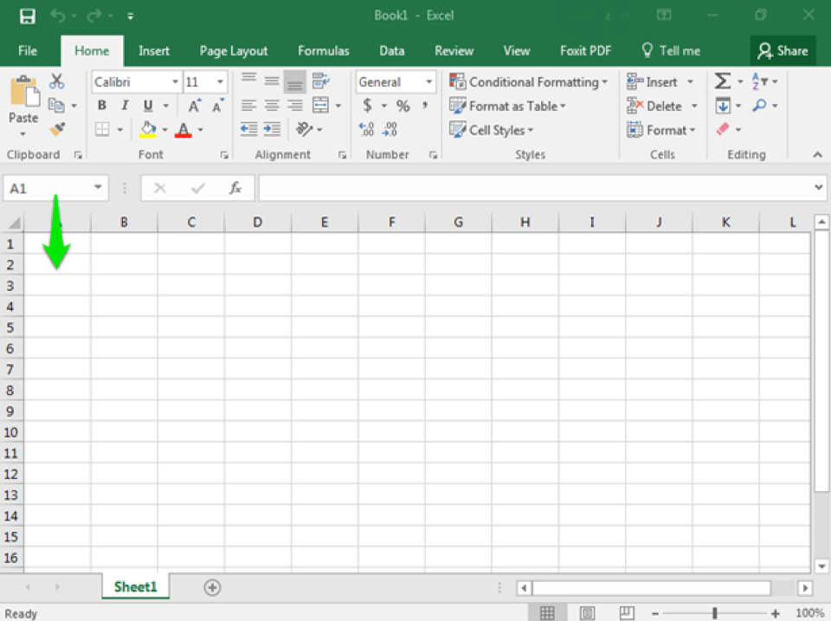
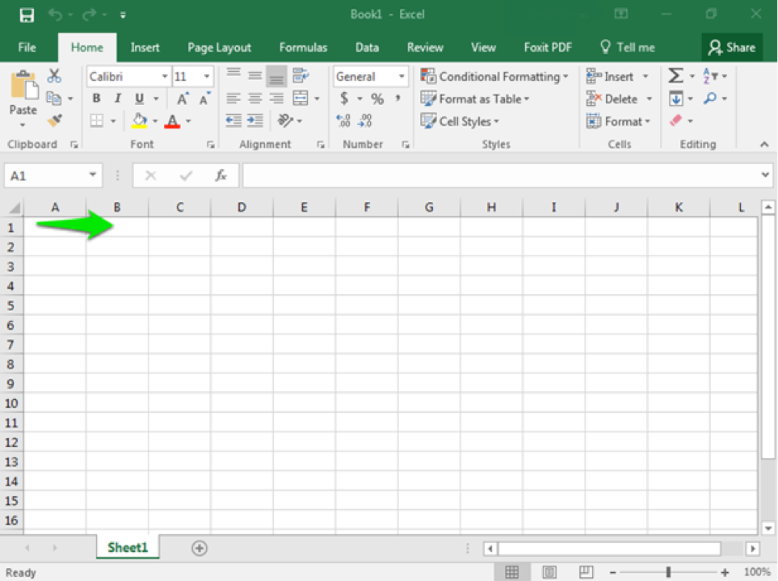
Enter Data into a Table
Open blank worksheet- first cell is A1, then A2, etc.
To move over, use the TAB key
B1, B2, etc.

Slide 7
Practice Question 1
What does Irene use to move easily from cell to cell to enter data into her new Excel worksheet?
The space bar.
The tab key.
The shift key.
The right-click mouse key.
Notes:
The correct answer is B.

Slide 8
Basic Formatting and Layout

Slide 9
Learning Outcomes: Basic Formatting and Layout
6.2: Change formatting, layout, and styles in Excel
6.2.1: Apply table styles
6.2.2: Apply cell styles
6.2.3: Change cell format
6.2.4: Change comma style
6.2.5: Add, delete, and move columns and rows
6.2.5: Change width of columns and rows

Slide 10
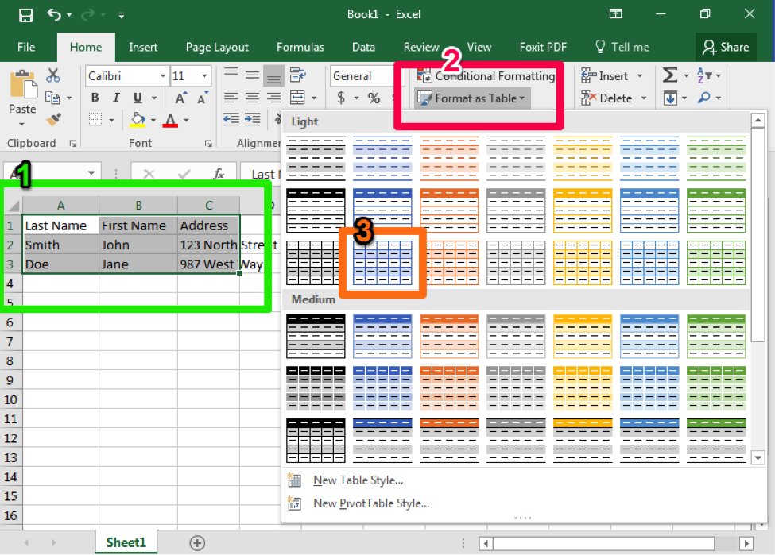
Styles within Excel
Table style
Select cells that belong in table
Click “Format as Table” button
Choose style to apply
Apply cell styles
Default styles

Slide 11
Change Default Cell Displays
Format methods
Highlight cells, select ”Format” dropdown from “Cells” (1)
Use “Number” group (2)
Change comma style
“Format cell” drop down menu- select “Use 1000 Separator (,)” (1)
“Comma Style” in “Number” group (2)
“Comma”- 2 decimals
“Comma [0]”- no decimals
“Currency”0- 2 decimals and $ sign

Slide 12
Rearrange Tables: Adding and Deleting
Add Columns and Rows
Method 1
Identify area
Right-click to right of area where column will go
Select “Insert”
Method 2
”Insert” in “Cells” group- column will be inserted to left
Delete columns and rows
Method 1
Right-click column
Select Delete from pop-up window
Method 2
“Delete” button in “Cells” group

Slide 13
Rearrange Tables: Moving Columns and Rows
Move Columns and Rows
Method 1
Right-click column
Select “Cut” from pop-up window
Right-click column to LEFT of column
”Insert Cut Cells” column
Method 2
Right-click
Ctrl+X
Select column to LEFT of column
Ctrl+V

Slide 14
Practice Question 2
Jeremy created a new table filled with data in Excel. Since the table is large it becomes difficult to tell which data fits which left side month. What should Jeremy do to make his table a bit more legible and easier to read?
Use table styling.
Use different cell formats.
Change the comma style.
Move columns and rows.
Notes:
The correct answer is A.

Slide 15
Using Multiple Worksheets

Slide 16
Learning Outcomes: Using Multiple Worksheets
6.3: Create a new workbook with more than one worksheet
6.3.1: Create a new workbook with more than one worksheet

Slide 17
Workbook with Multiple Worksheets
Method 1
”Insert Worksheet”- ”+” button at bottom of window
Method 2
Menu option- Insert>Insert Sheet at “Cells” group in ribbon

Slide 18
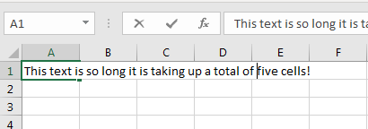
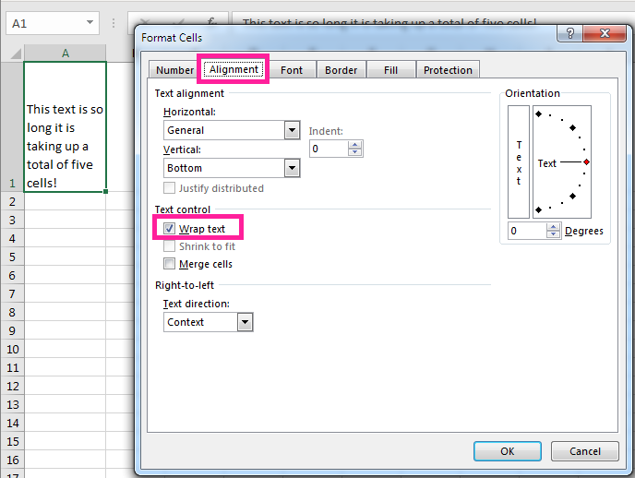
Class Discussion: Cell Wrapping
You have learned how to change cell formats to better display the type of data in a cell. But what happens if the text in a cell is very long and looks like it is extending over multiple cells? There is an option to use for unwieldy text called “cell wrapping.”
Steps to Text Wrap
Select text box
Right-click > Format Cells
Alignment > Check Wrap Text
OR
Home > Cells > Format > Format Cells
Alignment > Check Wrap Text

Slide 19
Class Discussion: Cell Wrapping (cont.)
With your classmates, discuss the following:
Do you think you will use this text wrapping tool? If so, when?
Do you know another way of condensing text in Excel? If so, how?
Which method will you use the most right-click or Cells group path?

Slide 20
Class Activity: Team Create Multiple Worksheet Workbook
Groups: Break into teams of 3–4
Create One Excel Workbook: 6–8 Total Worksheets (2 minimum per person)
Populate Worksheets:
Populate each worksheet with small, different stylized tables.
Be creative with your data, table and cell styles, labels, subjects and cell formats.
Name each of the worksheets a different name.
Questions: Ask yourself and others and share thoughts.
Did you discover something new about Excel while working with others? If so, what?
What types of questions arose while creating these worksheets? Did you find the answers? If so, what were they?
What else would you like to know about worksheets and how to use them?

Slide 21
Quick Review
Can you create a new Excel table?
Are you now able to add data to a table?
Do you know how to apply table/cell/comma styles and formats?
How do you add/delete/move/change the width of columns and rows?
Can you create a new workbook with multiple tabs/worksheets?

