Slide 1
Computer Applications for Managers
Microsoft Word Advanced Skills
Notes:
Cover Image: "Untitled Image." Authored by: Christin Hume. Provided by: Unsplash. Located at: https://unsplash.com/photos/mfB1B1s4sMc. Content Type: CC Licensed Content, Specific Attribution. License: CC0: No Rights Reserved. License Terms: Unsplash License.
All text in these slides is taken from https://courses.lumenlearning.com/wm-computerapplicationsmgrs/ where it is published under one or more open licenses.
All images in these slides are attributed in the notes of the slide on which they appear and licensed as indicated.

Slide 2
Module Learning Outcomes
Perform advanced tasks in Microsoft Word
5.1: Use templates and text effects
5.2: Insert watermarks and icons
5.3: Insert citations
5.4: Perform a mail merge
5.5: Use internet tools to enhance Word documents

Slide 3
Advanced File Creation

Slide 4
Learning Outcomes: Advanced File Creation
5.1: Use templates and text effects
5.1.1: Create document from template
5.1.2: Change text using text effects

Slide 5
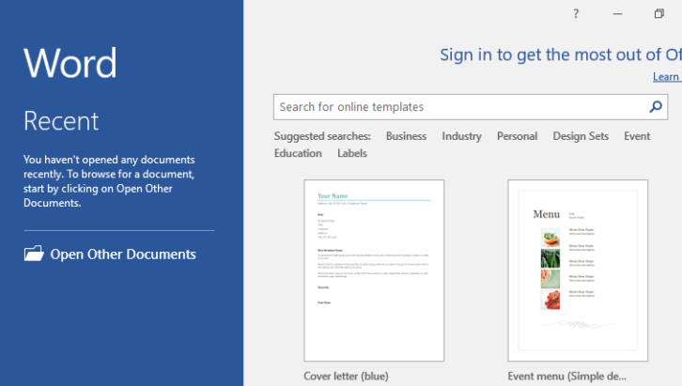
Create Document from Template
Search box and suggestions near top of screen (eg. Business)
Download template

Slide 6
Text Effects
Text Effect menu (next to font color)
Outline
Applies border
Shadow
Applies shadow to letters
Color, transparency, blur, angle, distance
Reflection
Letters as held up to mirror
Glow
Fuzzy colored shape to letters

Slide 7
Watermarks and Icons

Slide 8
Learning Outcomes: Watermarks and Icons
5.2: Insert watermarks and icons
5.2.1: Insert a Watermark
5.2.2: Create a Word document with an inserted icon

Slide 9
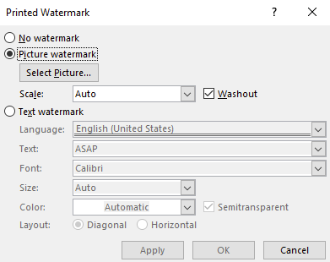
Watermarks
Design>Watermark
Custom Watermark option
Add image
Design>Watermark>Custom watermark

Slide 10
Practice Question 1
Larry wrote the first draft of the marketing report for his team. He is now looking to insert a draft watermark in his document to not have it mistaken for the finished report. Where is the watermark button located?
Insert tab > Illustrations group
Layout tab > Arrange group
Design tab > Page Background group
View tab > Draft button
Notes:
The correct answer is C.

Slide 11
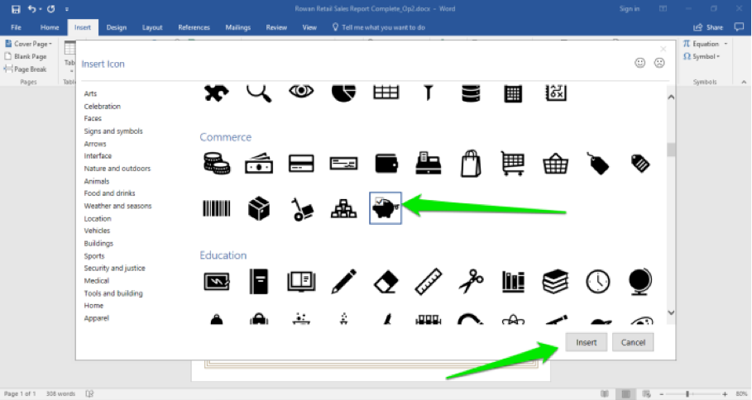
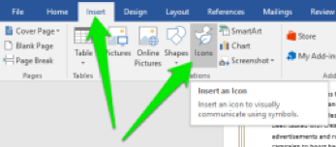
Icon Integration in Word
Insert > Icon
Search for Icon
Select > Insert

Slide 12
Citations

Slide 13
Learning Outcomes: Citations
5.3: Insert citations
5.3.1: Insert citations

Slide 14
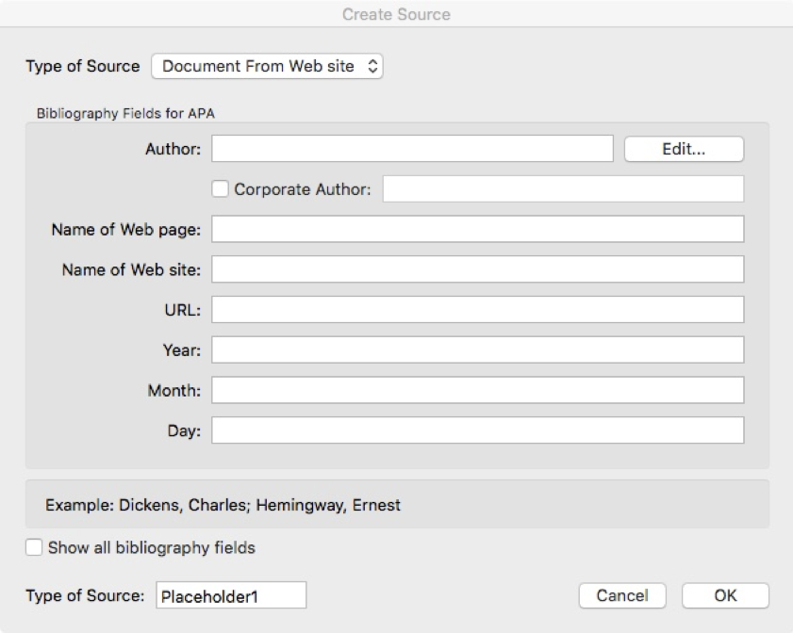
Understanding Citations
References > Insert Citation
Add New Source
Type in information into Citation Source Box

Slide 15
Mail Merge

Slide 16
Learning Outcomes: Mail Merge
5.4: Perform a mail merge
5.4.1: Perform a mail merge

Slide 17
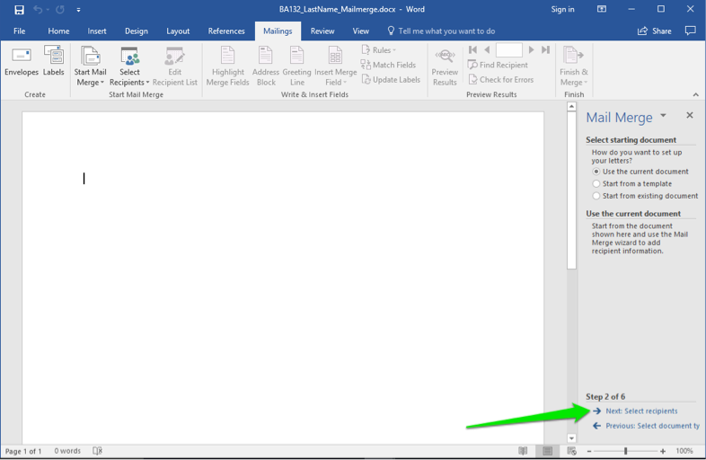
Understanding Mail Merge
Mailings > Start Mail Merge
Step by Step Mail Merge Wizard
Follow steps in wizard
Start new or use existing document
Merge data source file
Edit
Create

Slide 18
Internet and Word

Slide 19
Learning Outcomes: Internet and Word
5.5: Use internet tools to enhance Word documents
5.5.1: Use internet tools to enhance Word documents

Slide 20
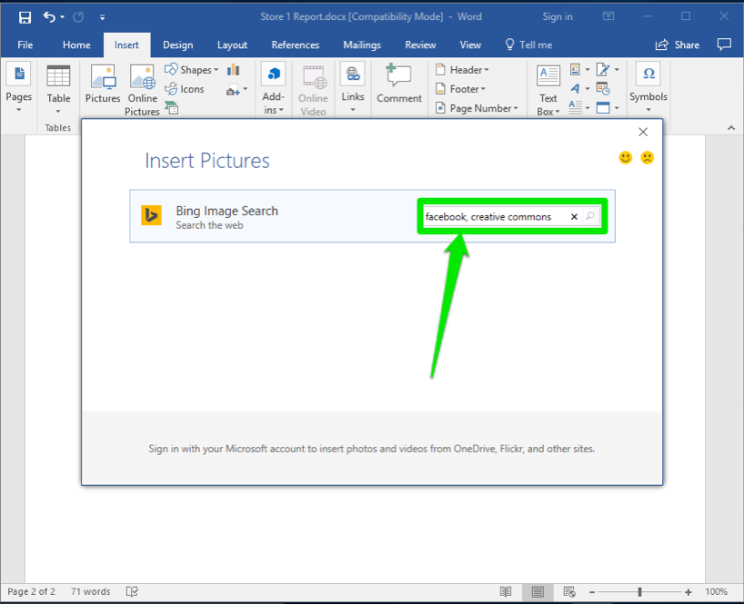
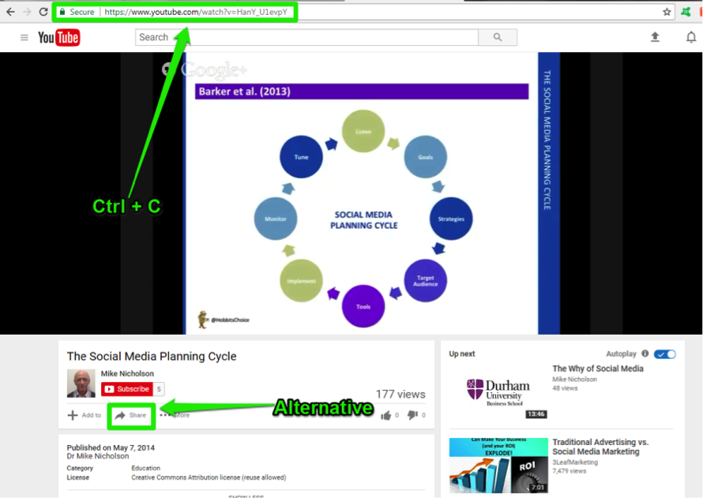
Internet Tools & Word
Internet Tools:
Searches
Images & Graphics
Videos
Sources
Icons
Audio
Etc.
Insert tab for most

Slide 21
Practice Question 2
Kelli has written a sales document for her team, but it is lacking a few elements to make it memorable. She searched the internet discovering a few images she wants to use in the document. What is the correct way to use these images inside her document?
Select the internet address of the image page and creates a hyperlink to it.
Use the Insert tab and the Online Pictures button to insert image.
Click the Picture button in the Insert tab, find the image on her computer and upload it into the document.
Use Insert tab, Online Pictures button, insert the image and cite the online source in a citation.
Notes:
The correct answer is D.

Slide 22
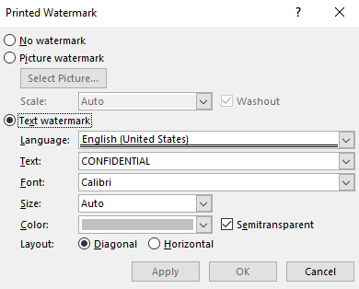
Class Discussion: Format Painter
There are a few options when it comes to watermarks in Word. You’ve learned the basic steps, using an image, and even custom watermarks? Here is a refresher for the custom watermark steps. Make your own mark and then share with at least two classmates and answer these questions.
Custom Watermark Steps
Design tab > Watermark button
Custom Watermark > Text Watermark
Type in custom text and ‘Apply’ > OK

Slide 23
Class Discussion: Format Painter (cont.)
Discuss the following with your classmates:
What are a few reasons you would use a custom Watermark in business?
What are a few examples of custom Watermarks?
When do you think custom Watermarks are good to use? When are they not?

Slide 24
Class Activity: Protect a Document
Protect a document from the backstage view.
Break into teams of 3-4 people.
Watch this 3-minute video walking through how to finalize and protect a document.
Bring up a previously created Word document, finalize and protect it as a team then share and see if it worked.
Questions to ask afterward:
How was your experience finalizing and protecting your document?
Which option will you use the most?
How do you think business use this tool?
Share your findings with your classmates.
Notes:
All Rights Reserved
Title: Finalize and Protect Documents. Authored by: GCF LearnFree.org Located: https://www.youtube.com/watch?time_continue=186&v=G4ncX_8K2ss&feature=emb_logo License: Standard YouTube License
English captioning can be accessed on YouTube.

Slide 25
Quick Review
How do you create a document from a template?
How do you change text using text effects?
How do you insert a watermark?
How do you insert citations into a document?
What steps are needed to perform a mail merge?
How can internet tools be used to enhance a document?
Notes:
Title: Microsoft Word Shortcuts. Authored by: Located at: https://www.cmawebline.org/ontarget/15-most-useful-microsoft-word-shortcuts-that-you-probably-dont-use/. License: CC-BY

